Slide 1
Iowa Waste Reduction Center
iwrc.uni.edu
Jennifer Wittenburg - Program Manager
Jim Olson – Director

Slide 2
Intent of this Presentation
Outline
Briefly explain who we are
Provide an overview of Iowa’s air quality regulations
Provide an overview of Iowa’s storm water regulations
Identify resources available to Iowa small businesses
Introduce other IWRC services
Goal: to provide you with a basic understanding of air and water quality and other environmental regulations and share resources available to you and your clients

Slide 3
Who we are…
Founded from the 1987 Groundwater Protection Act
Department of Business and Community Services in the College of Business Administration at the University of Northern Iowa
IWRC’s Mission:
“Assist Iowa’s small businesses in complying with environmental regulations and implementing practical pollution prevention practices”

Slide 4
Our Staff…
Over 200 Years Combined Experience
12 Full-time staff | 3 Students
Areas of Expertise:
Air emissions - Air permitting, air toxics, emissions inventory
Food Waste
Hazardous/Nonhazardous Waste Determinations/ Disposal Practices
Painter Training (military and industrial)
Pollution Prevention
Spill Prevention Control and Countermeasure (SPCC)
Solid waste (i.e., beneficial reuse)
Storage tanks
Storm water / Storm Water Pollution Prevention Plans (SWPPP)
Testing parameters (i.e., toxic characteristic leaching procedures (TCLP))
Used oil
Wastewater
Universal waste

Slide 5
Air Quality Regulations
Regulated by the Clean Air Act
Managed nationally by the Environmental Protection Agency (EPA)
Managed in Iowa by the Iowa Department of Natural Resources (DNR) Air Quality Bureau
Purpose – to control air pollution and protect public health and public welfare

Slide 6
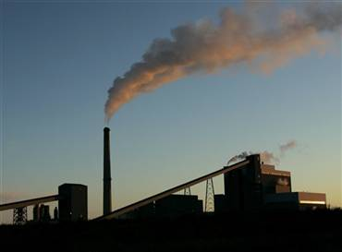
Regulated Air Pollutants
CO
PM₁₀
PM_{2.5}
HAPs
SO₂
Pb
NOx
VOCs

Slide 7
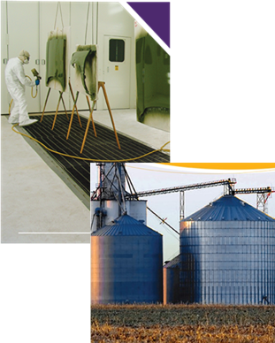
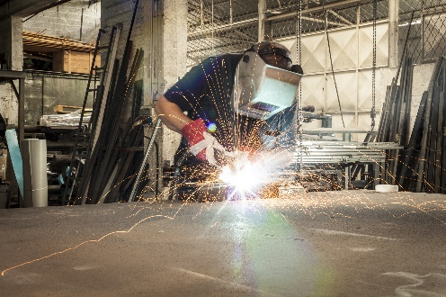
Common Emission Sources
Paint Booths
Welding Operations
Combustion Sources
Material Handling
Abrasive Blasting
Plasma/Laser Cutting
Grain Handling
Concrete Batching
Aggregate Processing

Slide 8
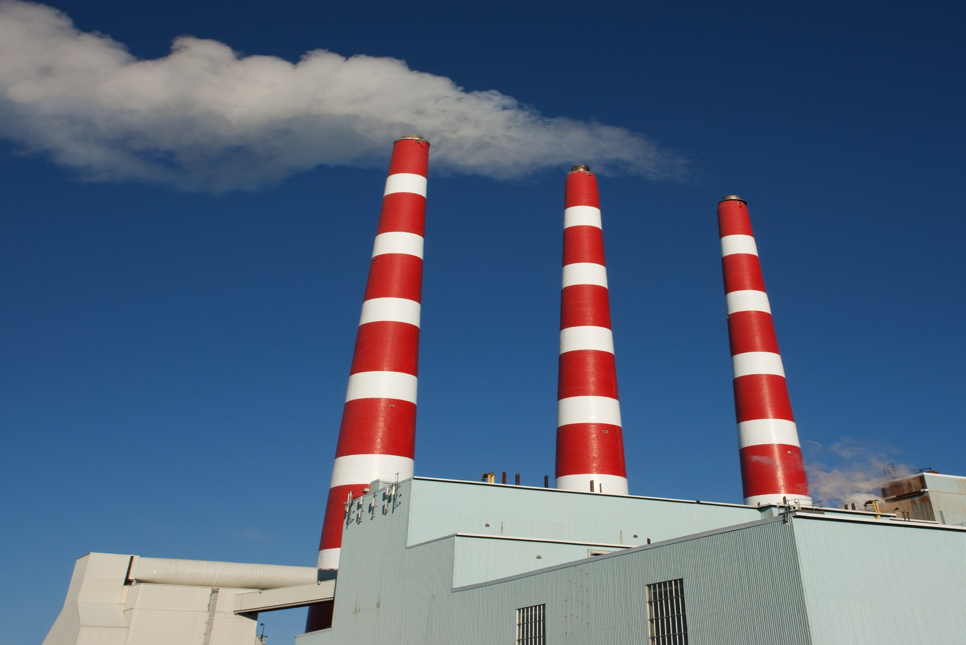
Major (Title V) vs Small Source
Based on Potential to Emit (PTE)
Major Source Thresholds
100 tons/yr criteria pollutants
10 tons/yr single HAP’s
25 tons/yr total HAP’s
≥ Thresholds: Major Source / Title V (subject to more stringent regulations)
< Thresholds: Small/Minor Source

Slide 9
Iowa Air Quality Regulations
Under Iowa law:
“All new or modified equipment and control equipment that emits air pollutants must have a construction permit unless the equipment is otherwise exempt.”
Permits need to be applied for and issued before construction begins.

Slide 10
Air Quality Permit Exemptions
Direct fired equipment burning natural gas < 10 mmbtu/hr
Direct fired equipment burning fuel oil < 1 mmbtu/hr
Nonproduction equipment or equipment vented indoors used for: cutting, machining, sawing, grinding, shot/sandblasting, etc.
Manually operated equipment used for a variety of purposes
Indoor vented powder coating equipment with filters
Welding with various usage limitations
Small Unit Exemption
A complete list of exemptions can be found in the
Iowa Administrative Code: 567 IAC 22.1

Slide 11
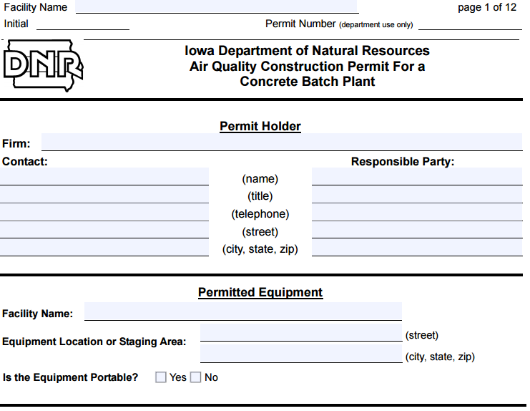
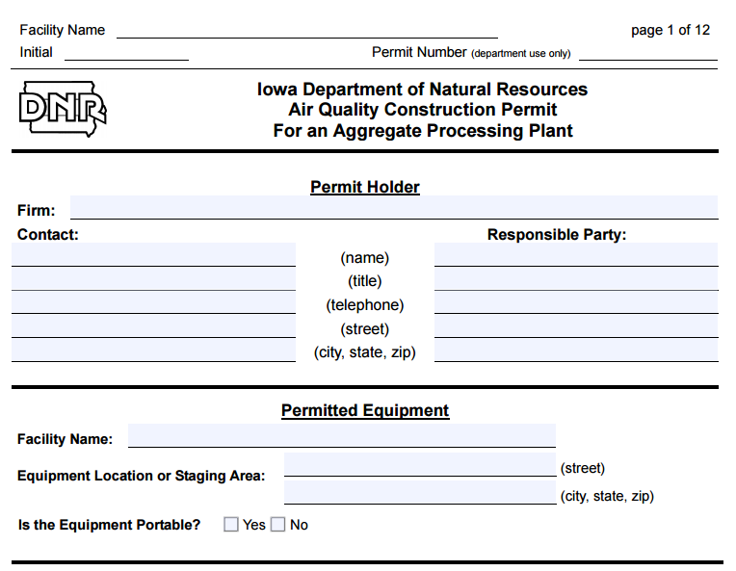
Permit Options
Permit-by-Rule: ($100 fee) surface coating operations
Registrations:
Engines <400 hp
Grain Elevators (Group 1) ($100 fee)
Permit Templates: ($100 fee)
Aggregate Processing Facilities
Asphalt Plants
Concrete Batch Plants
Gasoline Bulk Plants
Grain Elevators (Group 2)

Slide 12
Air Quality Construction Permit
Requires submittal of construction permit application
Company submits application forms to DNR
DNR engineer reviews application
Operating and monitoring conditions are determined
DNR issues the permit
DNR permit application fees apply
Minor Sources : $385/application
Major Sources: $115/hour for engineer review

Slide 13
Additional Requirements
Emissions Inventory
Minor Sources – once every three years
Major Sources – annual requirement
National Emissions Standards for Hazardous Air Pollutants (NESHAP)
Approximately 50 / 120 affect Iowa facilities
Boilers
Dry Cleaners
Gasoline (dispensing/bulk plants/terminals)
Metal Fabrication and Finishing
Surface Coating

Slide 14
Available Resources, Tools & Assistance
Iowa Air Emissions Assistance Program (≤ 100 employees)
https://iwrc.uni.edu/iaeap
Compliance assistance & tools (i.e., calculators & tutorials)
Technical assistance (on-site, detailed or brief)
Iowa Department of Natural Resources
www.iowacleanair.gov
Permitting forms, fact sheets, tools, regulatory guidance & frequently asked questions
Detailed information related to open burning, asbestos and fugitive dust
Permit Hotline: 877-AIR-IOWA (877-247-4692)

Slide 15
Iowa Storm Water Quality Regulations
Who must apply for a storm water General Permit
Certain types on industrial and commercial facilities (GP1)
Construction activities (more than 1 acre disturbed soil) (GP2)
Asphalt/concrete plants, rock crushers & quarries (GP3)
Large community storm water sewer systems (MS4)
Who must apply for a storm water Individual Permit
Facilities and construction sites that may temporarily degrade an Outstanding National Resource Water or Outstanding State Resource Water*
* Contact IWRC or DNR for determination

Slide 16
Iowa Storm Water Quality Regulations
Construction activity that disturbs > one acre (GP2)
Permit required before any soil is disturbed at the site.
Permit coverage must be continued until all construction is completed and the ground is completely stabilized with a permanent, perennial, vegetative cover.
Construction must be done following the recommendations in these DNR documents:
- Iowa Construction Site Erosion Control*
- How to Control Streambank Erosion**
* http://www.ctre.iastate.edu/erosion/manuals/const_erosion.pdf
** http://www.ctre.iastate.edu/erosion/manuals/streambank_erosion.pdf

Slide 17
Iowa Storm Water Quality Regulations
Application process for General Permit
Prepare a Storm Water Pollution Prevention Plan (SWPPP)
Public notice
Submit Notice of Intent (permit application form)
Pay applicable permit fees (one year - $175)
Must submit a Notice of Discontinuation when construction is completed and stabilization of soil has been completed.

Slide 18
Iowa Storm Water Assistance
Iowa Department of Natural Resources
http://www.iowadnr.gov/Environmental-Protection/Water-Quality/NPDES-Storm-Water
515/725-8415
Iowa Waste Reduction Center
https://iwrc.uni.edu/regulatory-information#storm-water-general-permits
319/273-8905

Slide 19
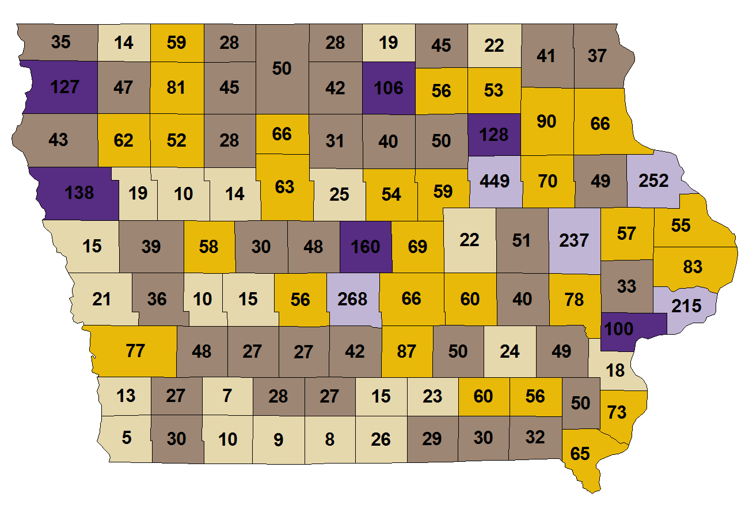
IWRC - Additional Services
On-Site Review Program
Free, non-regulatory, confidential services for Iowa businesses with < 200 employees
Provides comprehensive environmental compliance / technical assistance
Conducted over 6,000 state-wide

Slide 20
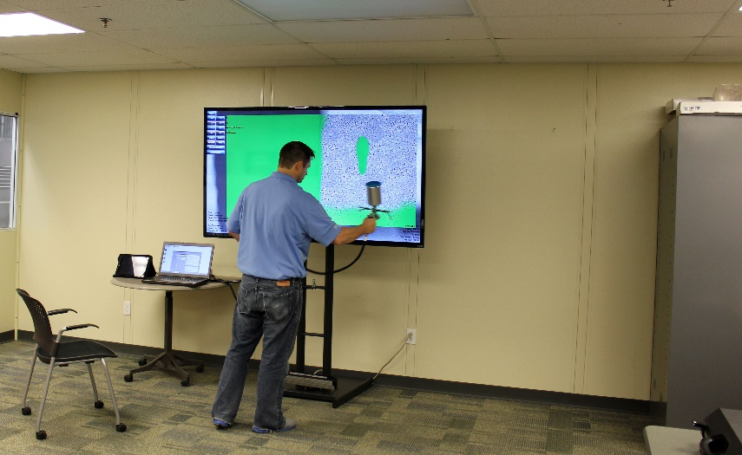
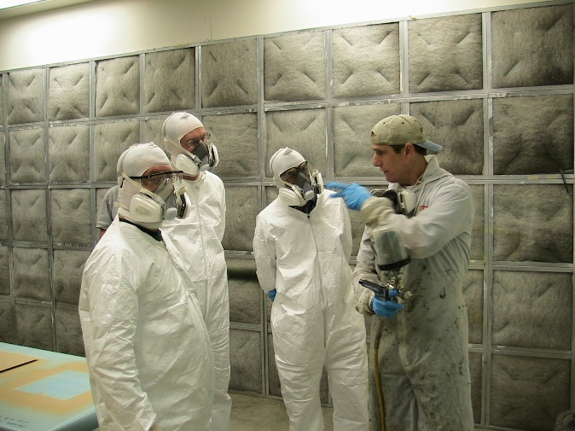
IWRC – Additional Services
Painter Training
Classroom, in-booth and virtual training
Customized training available
Fee-for-service program

Slide 21
IWRC Resources and Tools
Visit us at: https://iwrc.uni.edu
Call us at: 319-273-8905 or 800-422-3109
Regulatory summaries
Vendor lists
Direct one-on-one assistance
Record keeping assistance tools

Slide 22
QUESTIONS??
Jennifer Wittenburg - jennifer.wittenburg@uni.edu
Jim Olson - james.olson@uni.edu
319-273-8905 | iwrc.uni.edu

