Slide 1

Advisory Committee meeting intro slide
Advisory Committee Meeting
November 27, 2018
Courtyard by Marriott
Waterloo, IA

Slide 2
Committee Members
Bill Dotzler | IOWA SENATE
Matt Everson | NATIONAL FEDERATION OF INDEPENDENT BUSINESS
Jeff Fiagle | IOWA DEPARTMENT OF NATURAL RESOURCES
David Inyang | IOWA STATE UNIVERSITY
David Jackson | UNIVERSITY OF IOWA
Jan Loyson | CITIZEN REPRESENTATIVE
Dave Morgan | SINGLESPEED BREWING CO.
Randy Pilkington | UNIVERSITY OF NORTHERN IOWA
Jeff Phillips | BARKER LEMAR
Matt Rasmussen | IOWA ECONOMIC DEVELOPMENT AUTHORITY
Walt Rogers | IOWA HOUSE OF REPRESENTATIVES
Lisa Shimkat | IOWA SMALL BUSINESS DEVELOPMENT CENTER

Slide 3

Agenda
11:00 a.m. | Welcome and Introductions DAN NICKEY
 | On-Site Reviews and Iowa Air Emissions Assistance Program JENNIFER WITTENBURG
 | Food Waste Projects and 2018 Midwest Food Recovery Summit JENNIFER TRENT
 | STAR4D Military Painter Training Program TOM GIBLIN
 | Iowa Green Brewery Certification JOE BOLICK Environmental Training Initiative JIM OLSON Lunch
1:00 p.m. | Tour of UNI’s Additive Manufacturing Center TRAVIS FRUSH
 | Advisory Committee Discussion of the Future of the IWRC and Closing Remarks DAN NICKEY
12:00 p.m.
1:00 p.m.
2:00 p.m.
Notes:
Created in 1987 by the Groundwater Protection Act
Part of Business and Community Services at the University of Northern Iowa
Mission: Provide environmental consulting, assistance, training and education for entities with environmental impact or need
Services
Free and confidential
Funding
Landfill tipping fees
Grants and contracts
Licensing of the virtual training units
Staffing Reductions

Slide 4

On-Site Reviews and Iowa Air Emissions Assistance Program
On-Site Reviews and Iowa Air Emissions Assistance Program
Presented by:
Jennifer Wittenburg
IAEAP PROGRAM MANAGER

Slide 5
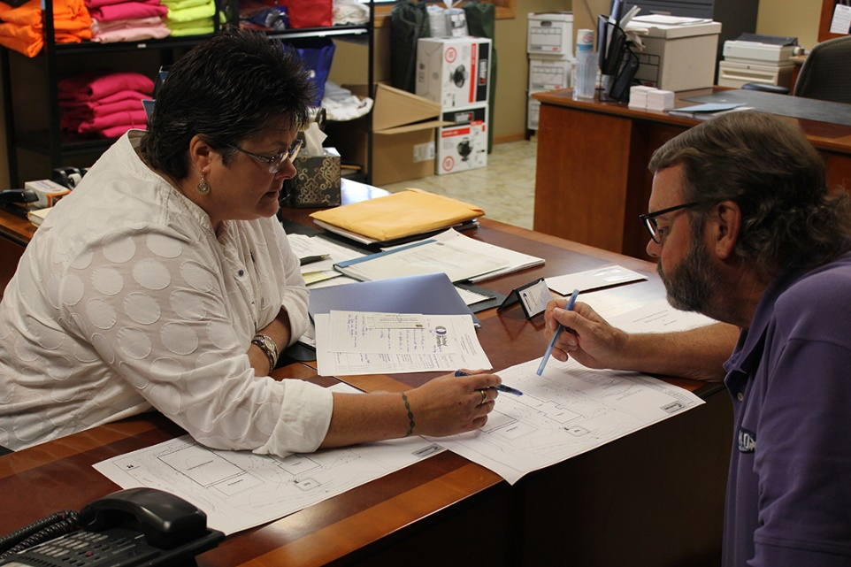
On-Site Reviews (OSR)
Free environmental consultations to Iowa small businesses (less than 200 employees)
Areas of Expertise
  Air Emissions
  Emergency Planning & Community Right-to-Know Act (EPCRA) reporting
  Food Waste
  Spill Prevention Control and Countermeasure (SPCC)
  Hazardous Waste
  Solid Waste
  Storm Water
  Used Oil
  Wastewater
  Universal Waste
  Storage Tanks

Slide 6
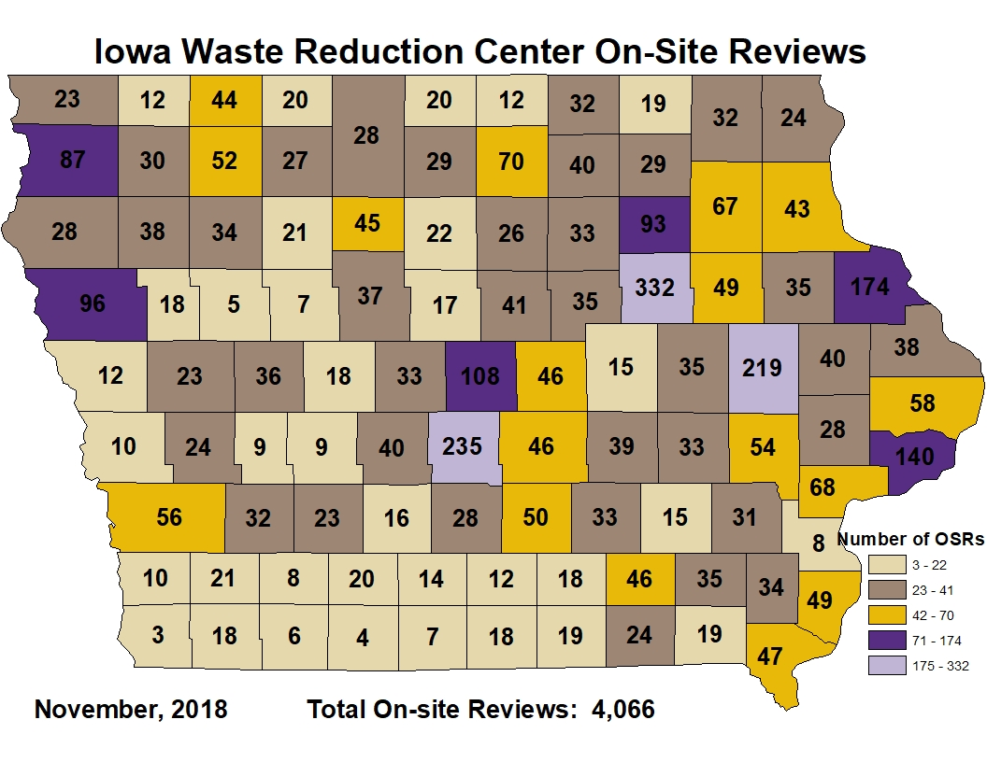
Our Reach as of November 2018
Total OSRs:
4,066

Slide 7


Iowa Air Emission Assistance Program (IAEAP)
Mandated by Section 507 of the Clean Air Act Amendments
Free technical and environmental compliance assistance to Iowa small businesses
  Less than 100 employees
Funded by the Iowa DNR Air Quality Bureau
    1.25 FTE Program

Slide 8
Iowa Air Emission Assistance Program (IAEAP)
  Services Provided (July 1, 2017 – June 30, 2018)
FY19 Special Project
  GrainPTE Update
Assistance Type | Brief Assistance | Detailed Assistance
Site Visits | 3 | 45
Construction Permits | 30 | 26
Permit by Rule | 3 | 5
Small Unit Exemption | 5 | 22
Emissions Inventory | 24 | 7
NESHAPs | 13 | 2
Paint Tracker | 6 | 2
GrainPTE | 23 | 1
Feed Mill | 2 | 0
Total | 130 | 110

Slide 9
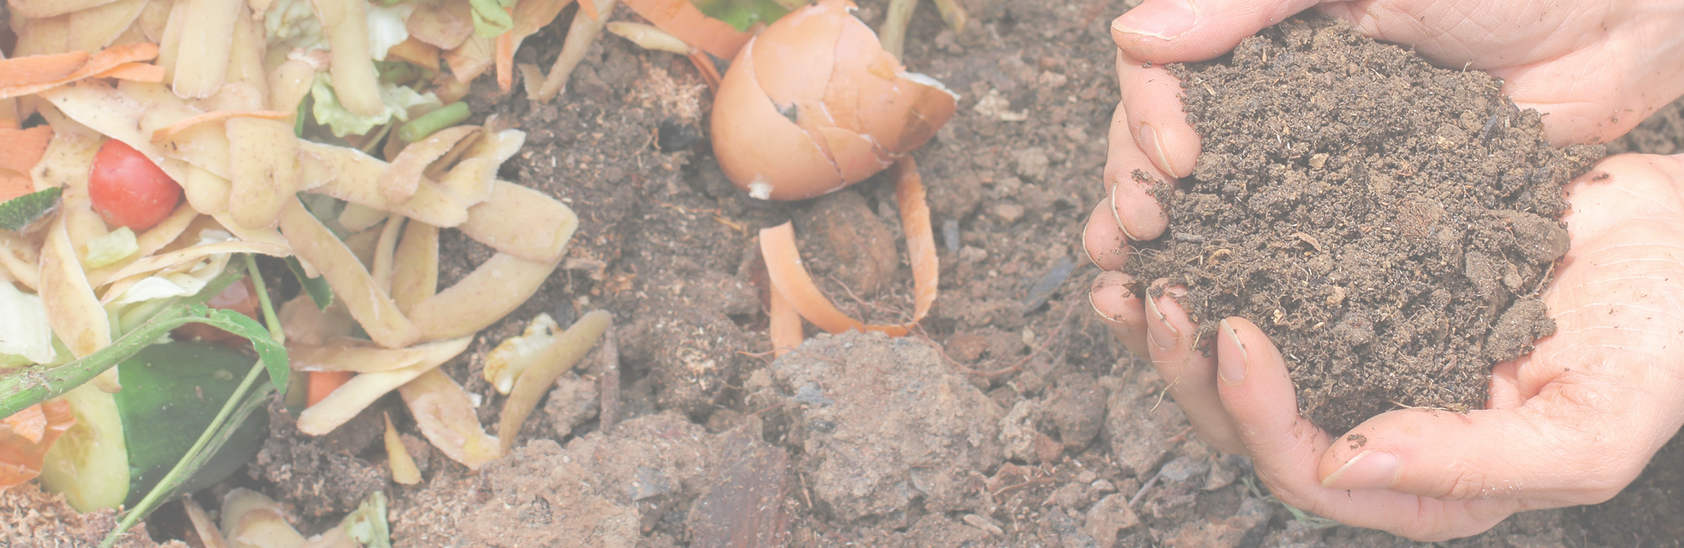
Food Waste Reduction Projects
Food Waste Reduction Projects
Presented by: Jennifer Trent
Reducing Food Loss in Iowa’s Rural K-12 Schools Project

Slide 10


USDA Project
Food waste prevention and reduction project in rural Iowa at K-12 Schools
  October 1, 2017 – October 30, 2018
Assistance Provided
  Food waste audits and waste sorts for K-12 Schools
    Kitchen Waste
    Student Tray Waste
  Final report sent to each participant
  Posters, training guides, fact sheet, supplies
  Case Studies

Slide 11
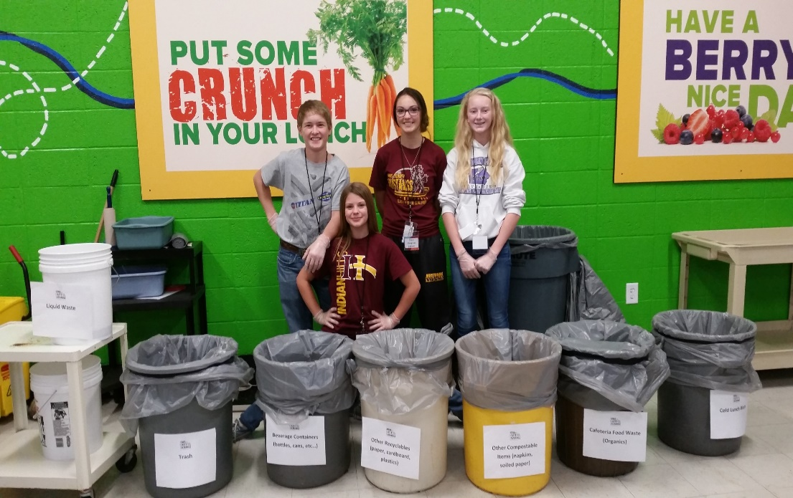
USDA Project
K-12 Schools / Districts Participants
Shenandoah CSD
Shenandoah – 1,200 meals
Clarke CSD
Osceola – 1,350 meals
South Central Calhoun CSD
Rockwell City and Lake City – 961 meals
Melcher-Dallas CSD
Melcher – 260 meals
Moulton-Udell CSD
Moulton – 192 meals
Twin Rivers Elementary School
Bode – 61 meals
Wapello CSD
Wapello – 474 meals

Slide 12
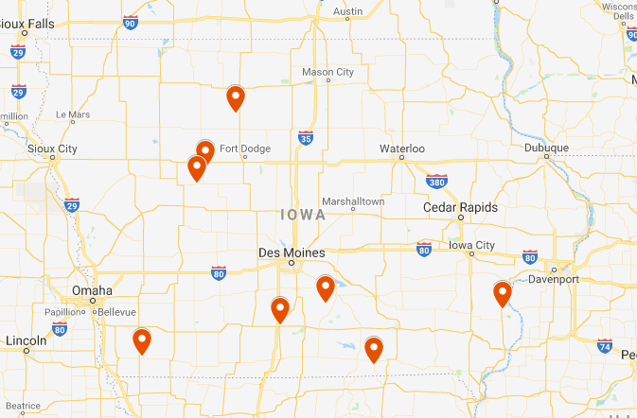
USDA Project
4,498 Meals Sorted Measured
& Recorded
October 2017-October 2018

Slide 13

Food Waste Reduction Posters
    Posters
    Order form available online and these beauties are FREE!
    https://iwrc.uni.edu/food-waste-posters

Slide 14
K-12 Schools Food waste data
Food waste data the IWRC has compiled since 2015. This is lunch food waste only.

Slide 15
Data compiled since 2015 Results – 19 Districts
Data compiled since 2015 Results – 19 Districts
Each Student tosses an extrapolated average of 0.3 pounds of food waste per day following lunch or about 57 pounds per school year.

Slide 16

Midwest Food Recovery Summit
Goal: To bring a comprehensive food waste reduction, recovery, and recycling event to the Midwest.

Slide 17
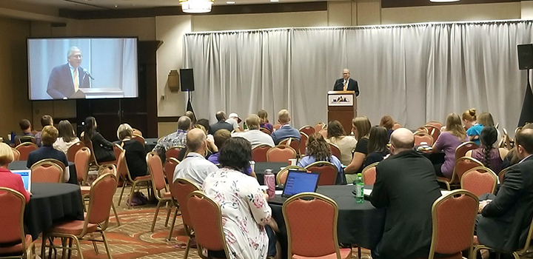
Two and a Half Days
Notes:
One keynote speaker Congressman Young
Two plenary discussions
17 breakout sessions
52 speakers and
Three special events

Slide 18
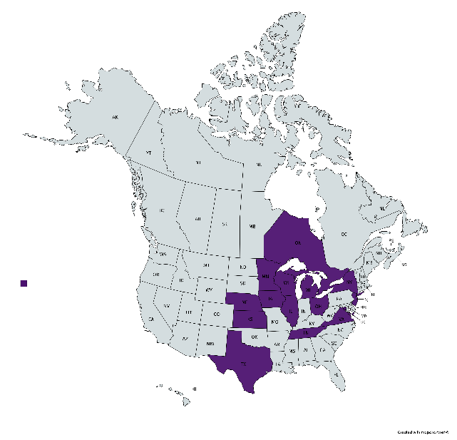
By the Numbers
Notes:
141 registered attendees
83 different organizations
13 states and Ontario Canada

Slide 19
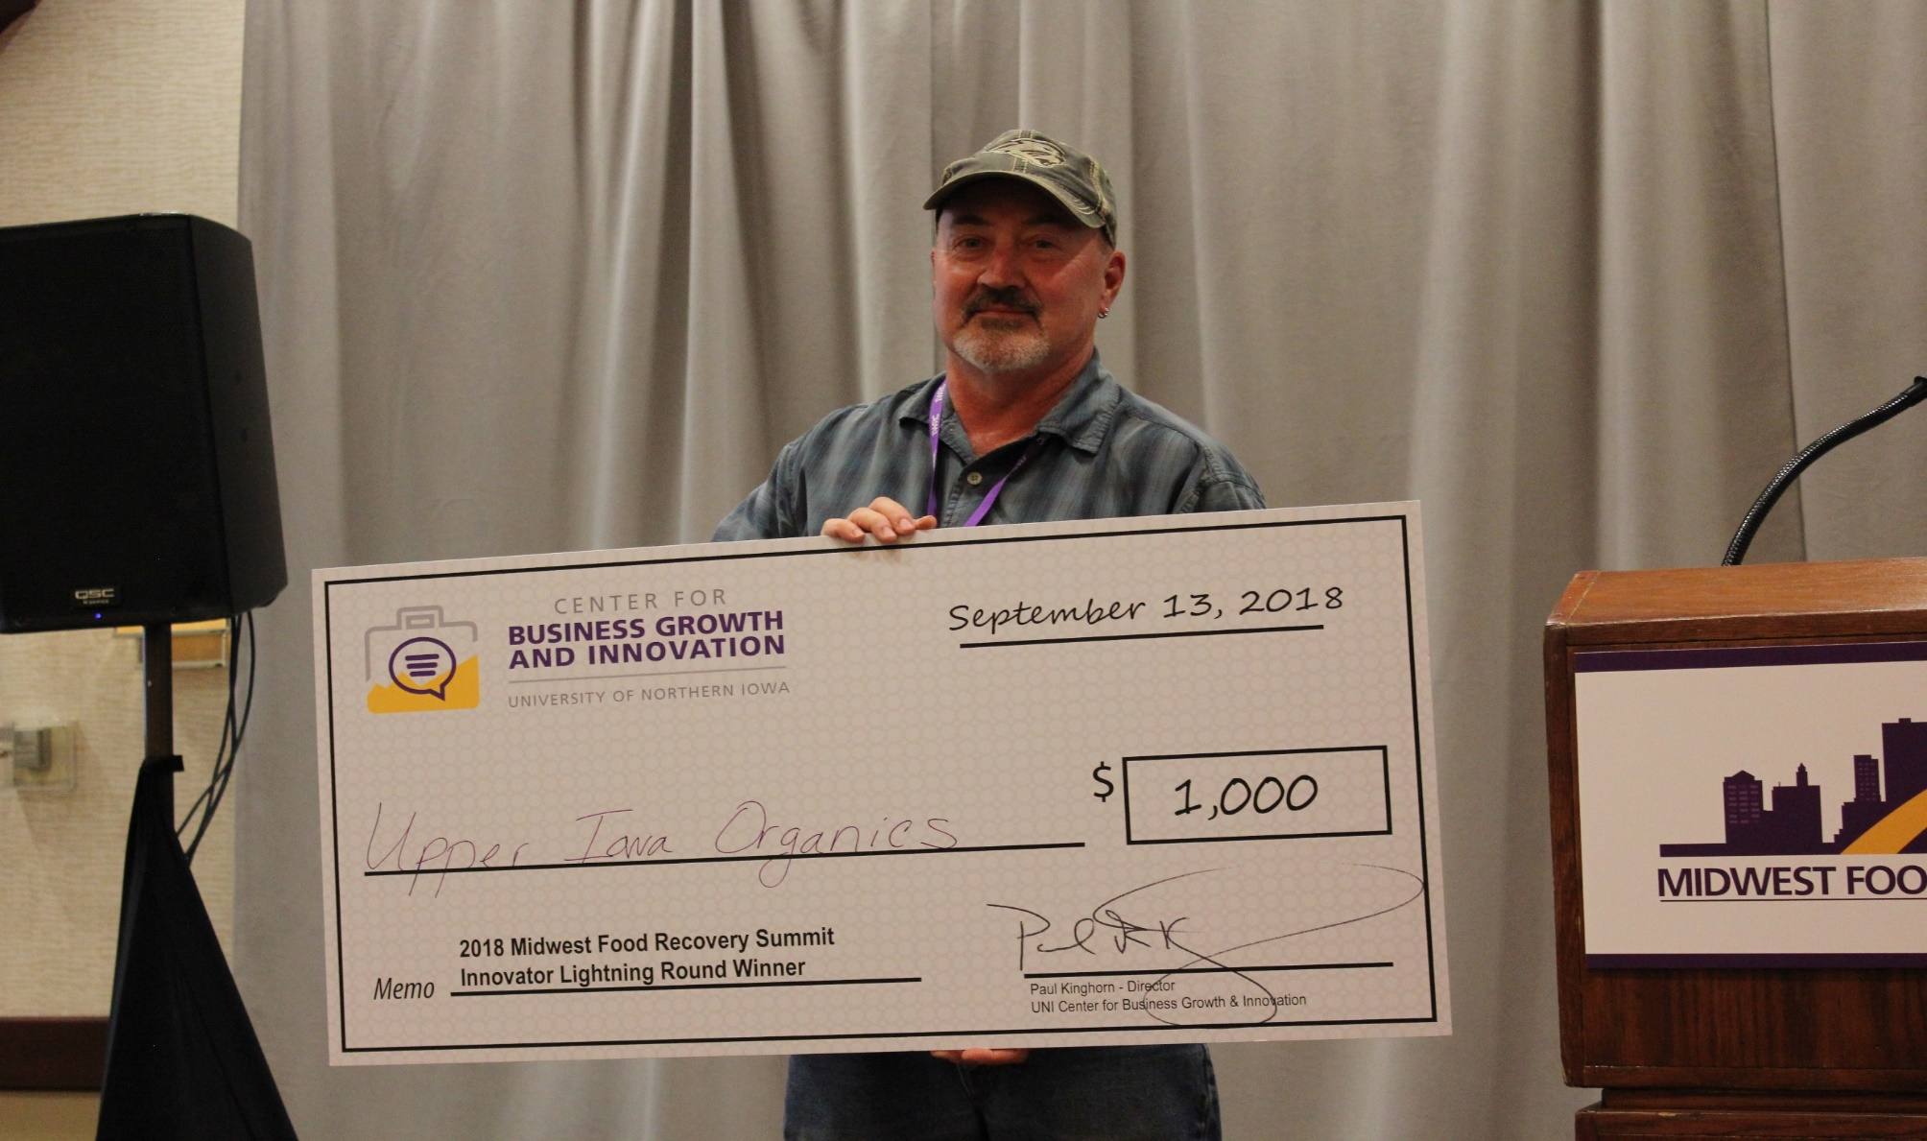
Innovator Lightning Round

Slide 20

The Main Event

Slide 21
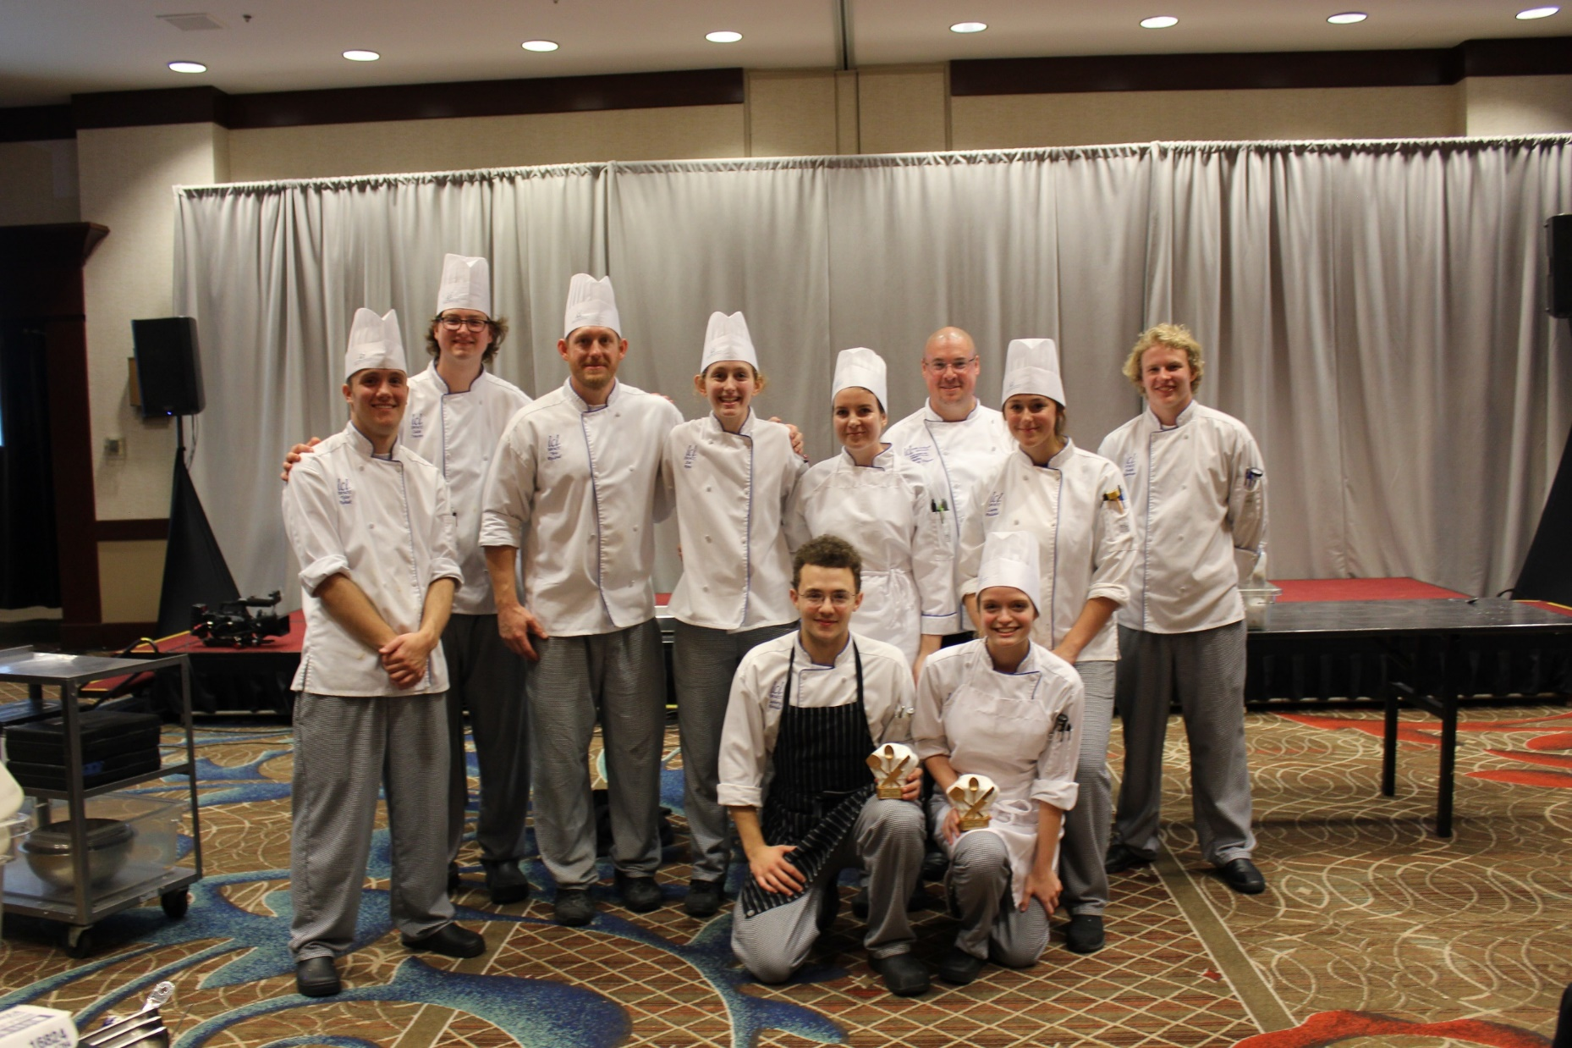
Savings Scraps: A Culinary Competition

Slide 22
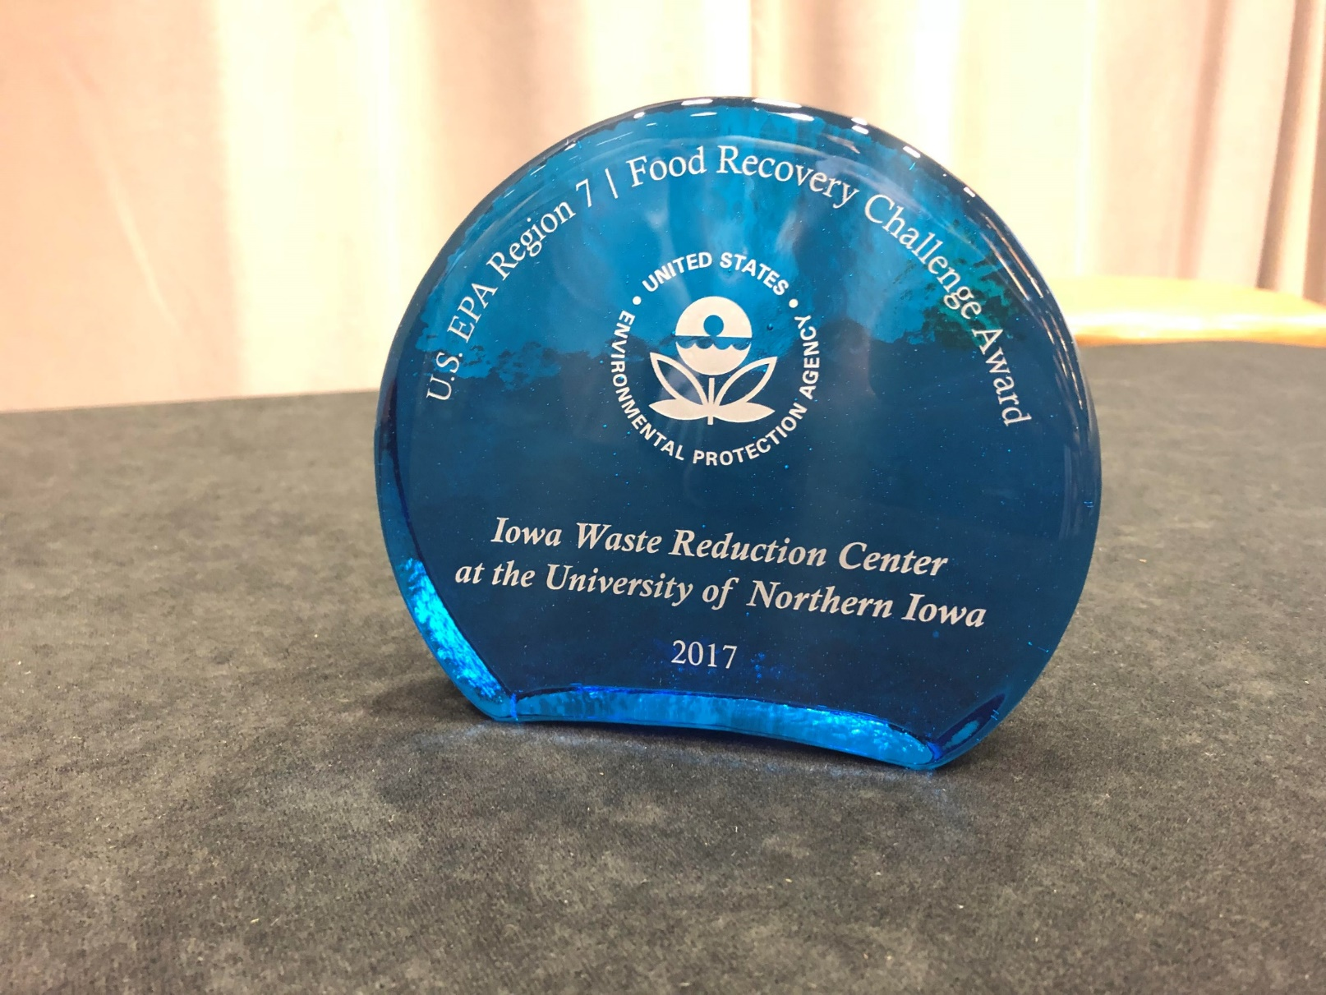
EPA Award Ceremony
Notes:
EPA Region 7 presented awards for their Food Recovery Challenge Awards

Slide 23
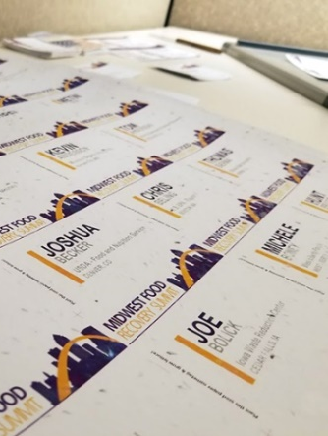
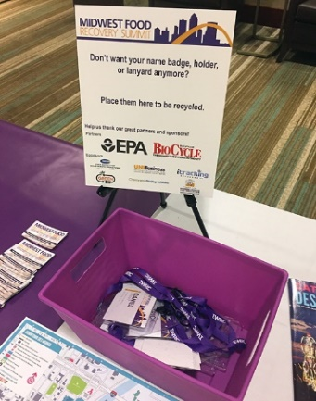
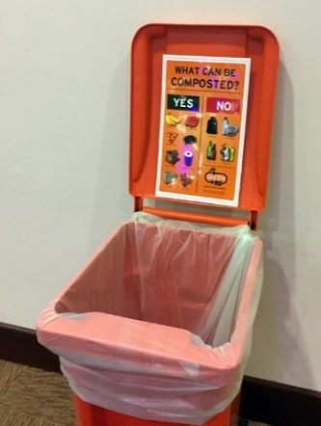
Sustainability at the Summit
All printed material recyclable or reusable
No printed conference program, used a mobile app
Name badges printed on seed paper
Option to recycle name badge holders and lanyards
All food waste composted and/or used in Saving Scraps: A Culinary Competition
Non-disposable plates, cups, and silverware used for meals
Recycling bins throughout the hotel

Slide 24
Outcomes
Overall summit experience rating of 4.7/5.0.
100% of responding attendees said they would be implementing and/or increasing food waste reduction, recovery, or recycling efforts.
What Others Said
“Thank you for hosting the summit. Much appreciated and believe attending was a good investment.”
“Loved the use of the conference app and the voting system. I also thought the AV company was a great idea. There were no technical glitches that I saw or that held up presentations like sometimes happens at other conferences. The food scraps cook off was so cool! I thought the seed paper name badges was also a nice touch.”
“Really broadened my horizons, from thinking primarily about food RESCUE to recovery more generally. Thank you!”

Slide 25


STAR4Defense
Presented by: Tom Giblin
Senior Research Technician

Slide 26
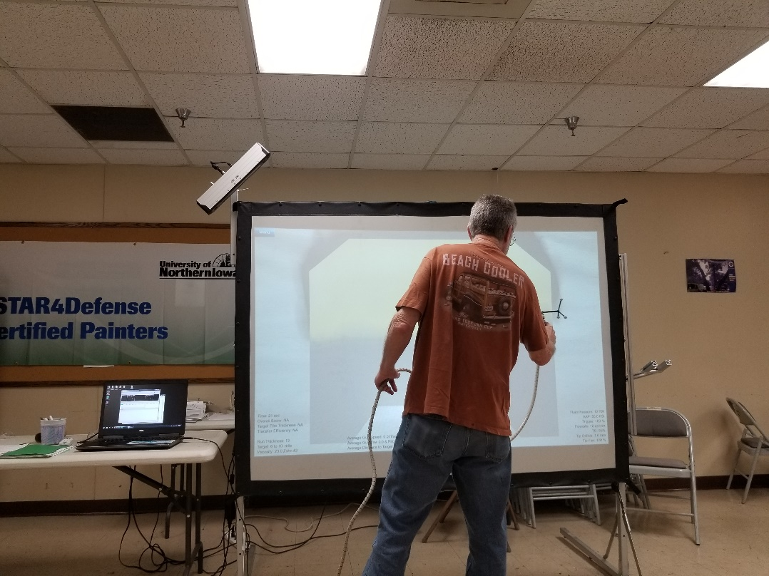
Painter Training
STAR4D classes at PACE and off-site training
  FY18 178 painters certified
  Certification training can take place in Cedar Falls or offsite at military facilities
  Certification is good for one year

Slide 27
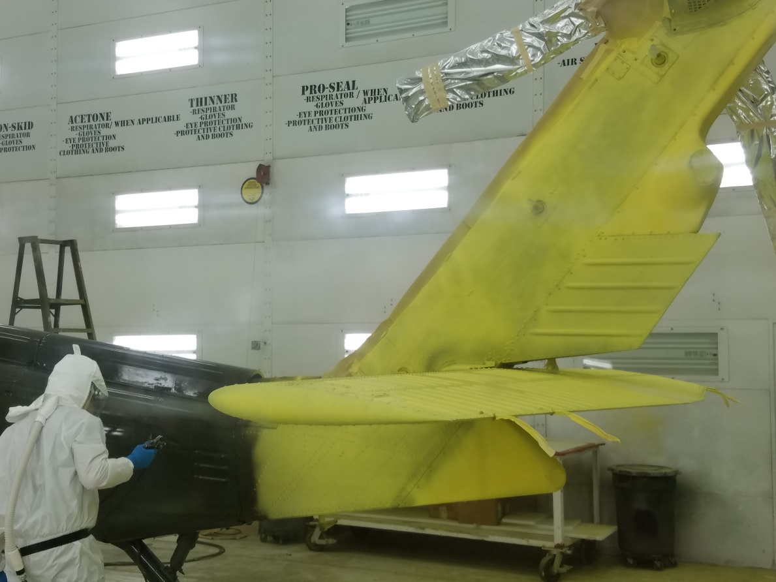
Training Locations
Army Aviation and Missile Command (AMCOM)
  Ft Fucker, AL
  Ft Campbell, KY
  Ft Bliss, TX
  Corpus Christi Army Depot, TX
  CT TASMG
  MO TASMG
  Waterloo Army Aviation Support Facility #1

Slide 28
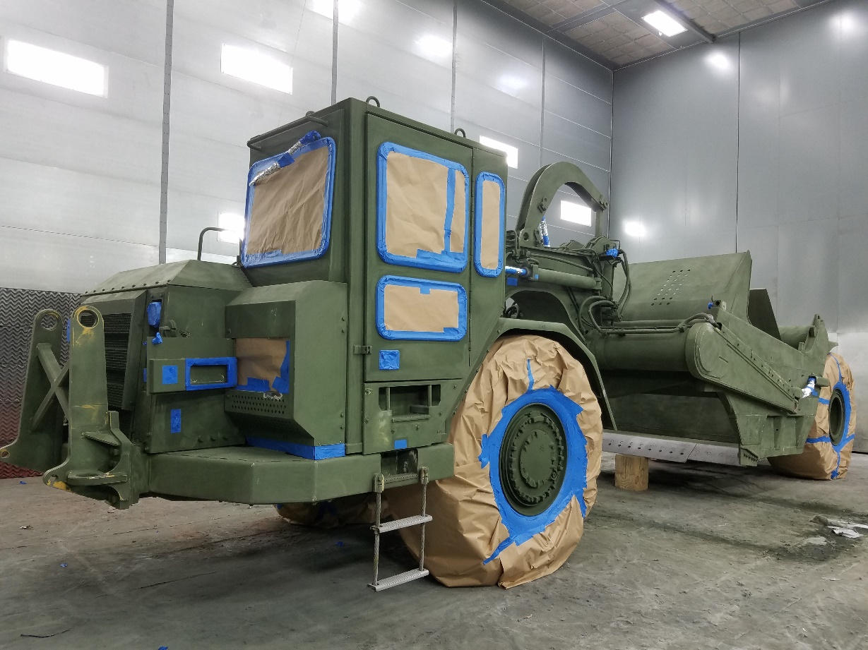
Training Locations
USMC Training
  MDMC Albany, GA
  MDMC Barstow, CA
  Camp Lejeune, NC
  Camp Pendleton, CA
  Kaneohe Bay, HI
  Blount Island Command, FL
  Camp Kinser Okinawa, Japan

Slide 29
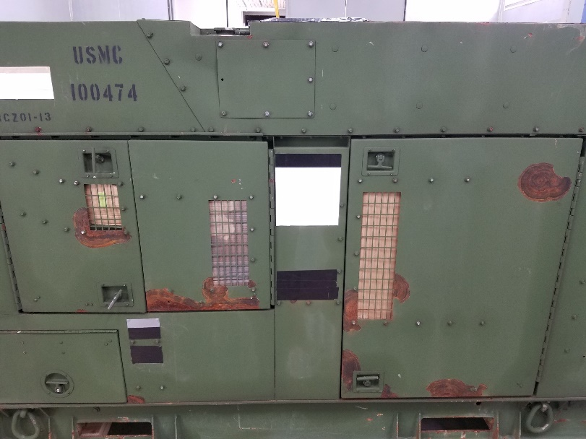
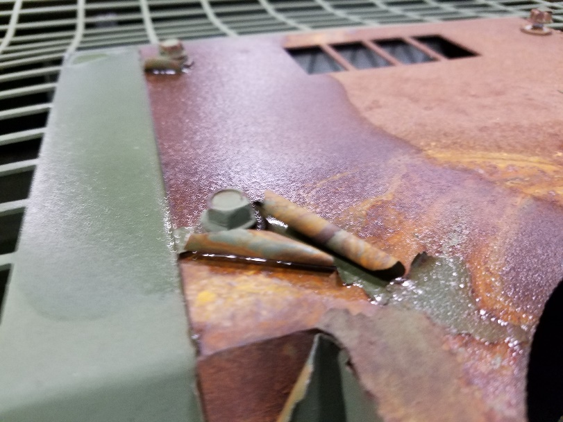
USMC Assets
  USMC reserve units send assets to STAR4D
  Category 2 or 3 (level of corrosion)

Slide 30
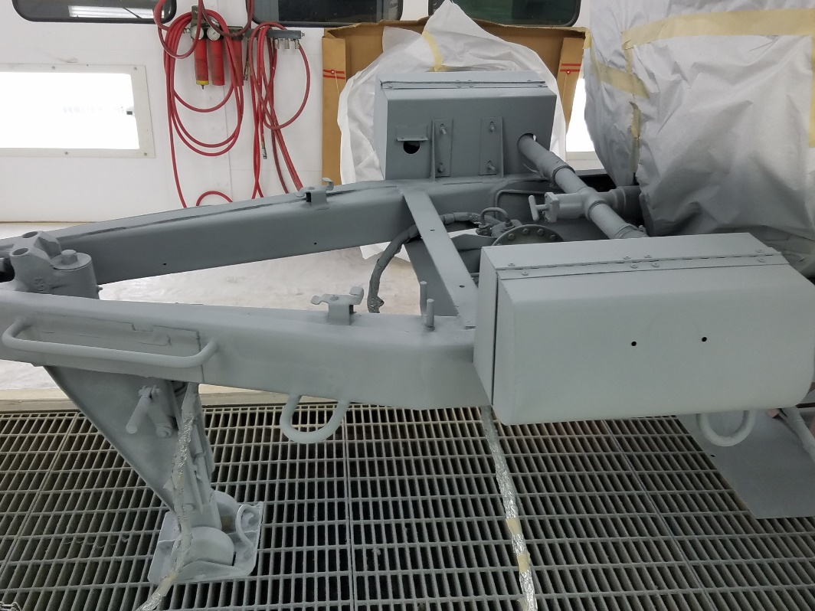
USMC Assets
  Zinc Rich Primer
  Environmental record keeping
    Temperature, Dew Point, RH
  Quality Assurance
    Film Thickness

Slide 31
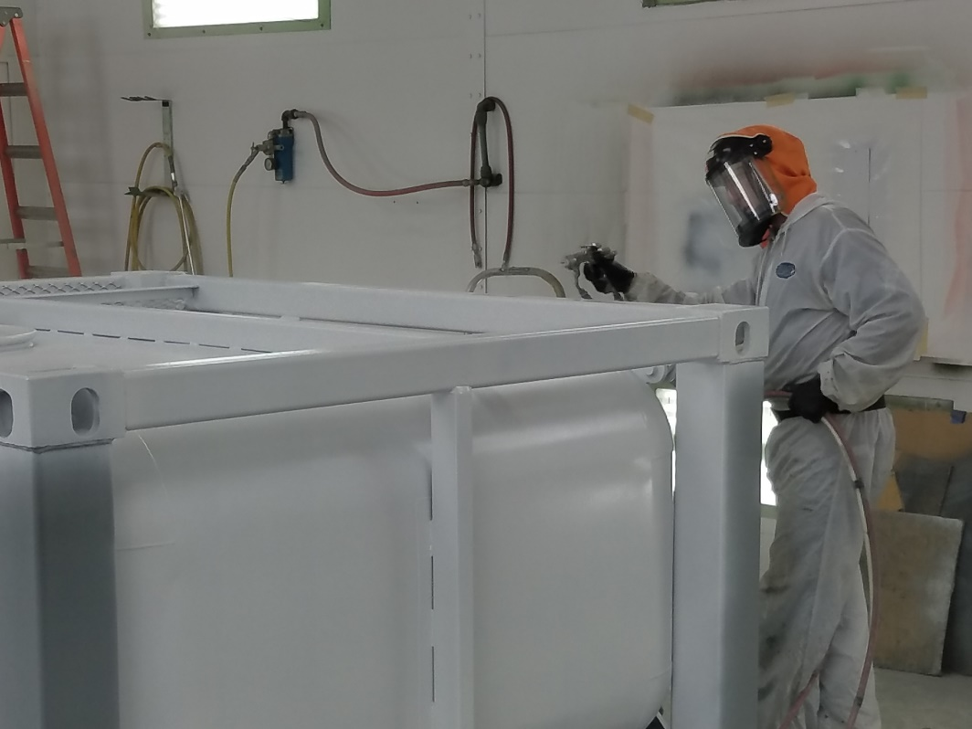
USMC Assets
  Epoxy Primer
  Environmental record keeping
    Temperature, Dew Point, RH
  Quality Assurance
    Film Thickness

Slide 32
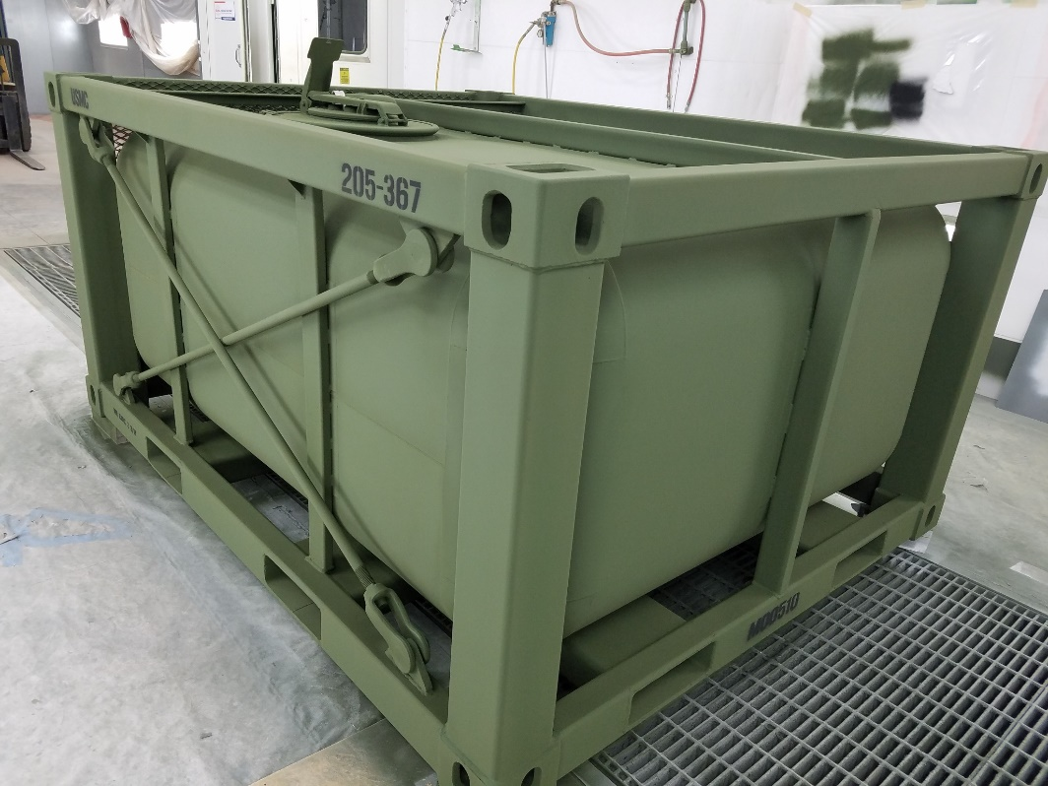
USMC Assets
  CARC (Chemical Agent Resistant Coating)
  Environmental record keeping
    Temperature, Dew Point, RH
  Quality Assurance
    Film Thickness

Slide 33
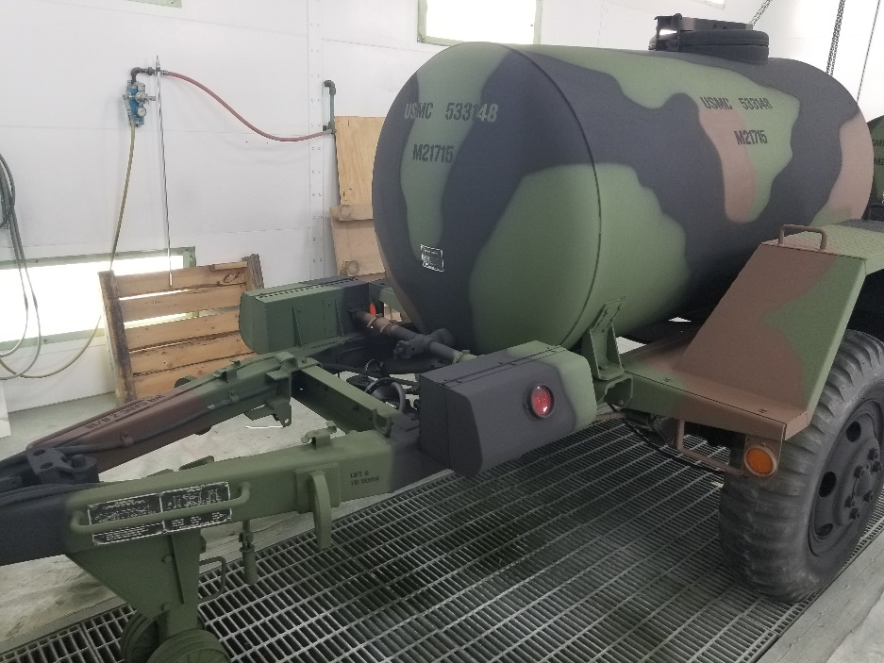
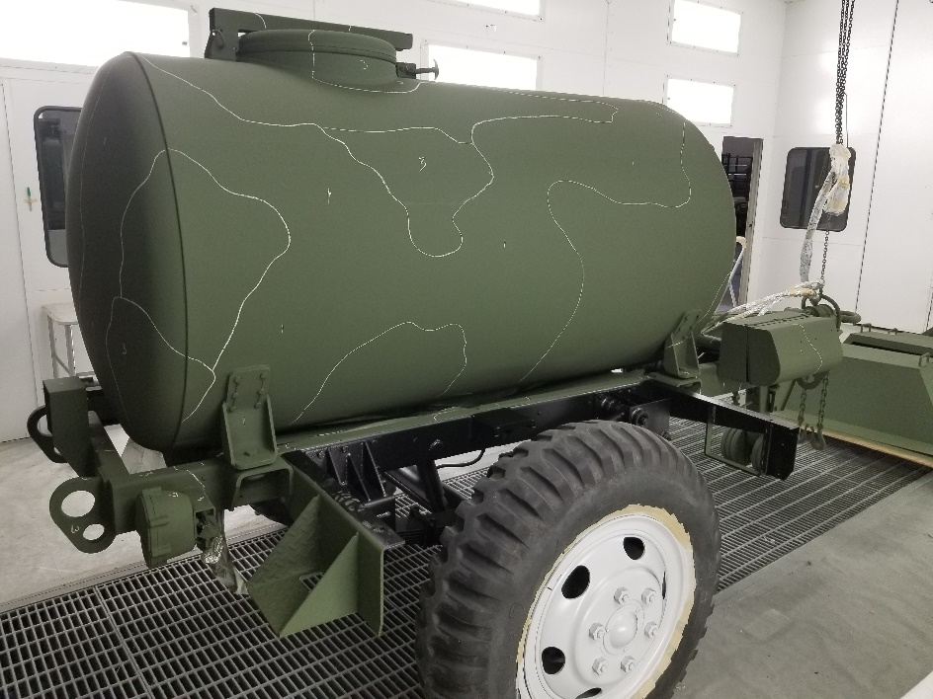
USMC Assets
  CARC (Chemical Agent Resistant Coating)
  Camouflage

Slide 34
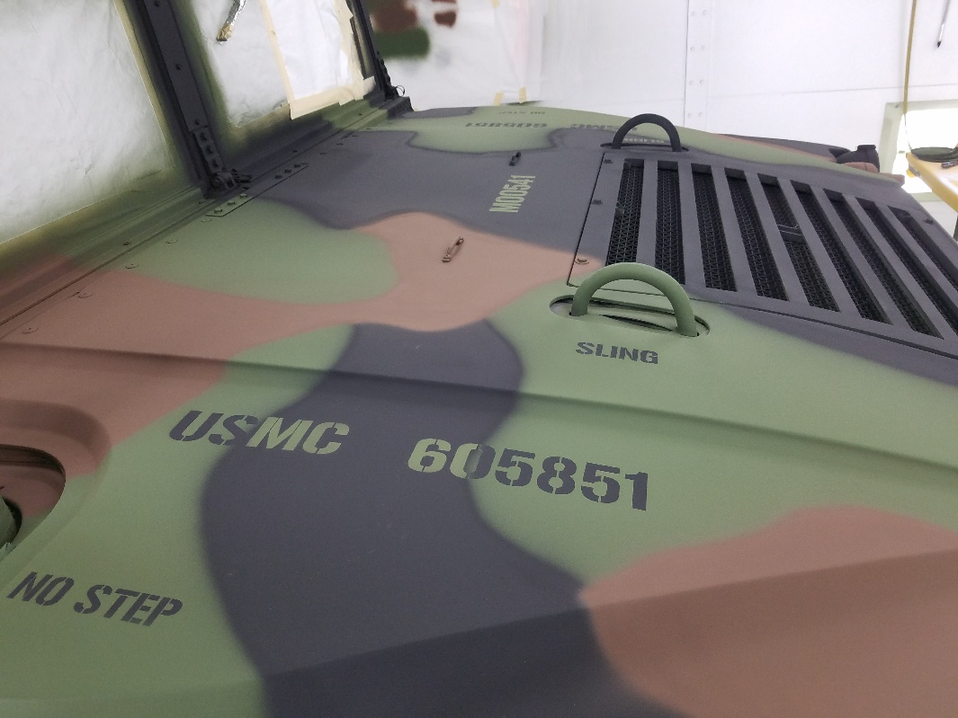
USMC Assets
  Stenciling
  UNI Graphic Technologies Program (students) provide stencils at a low cost using a laser cutter

Slide 35
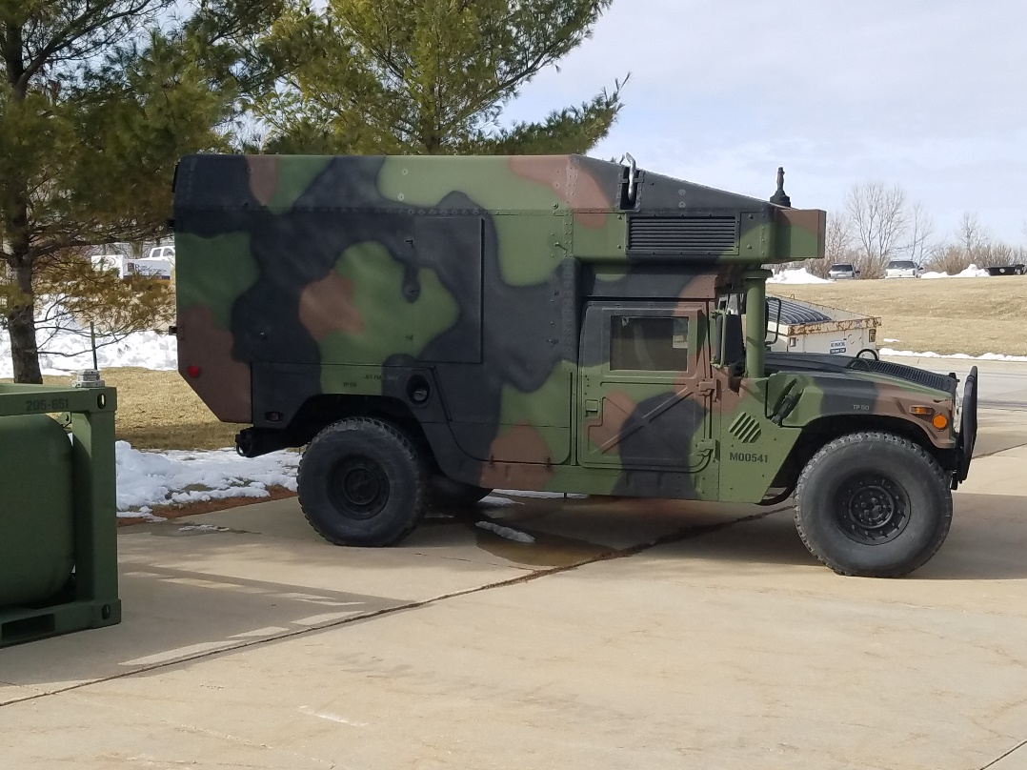
USMC Assets
  Return asset to a Category 1 (no corrosion)

Slide 36
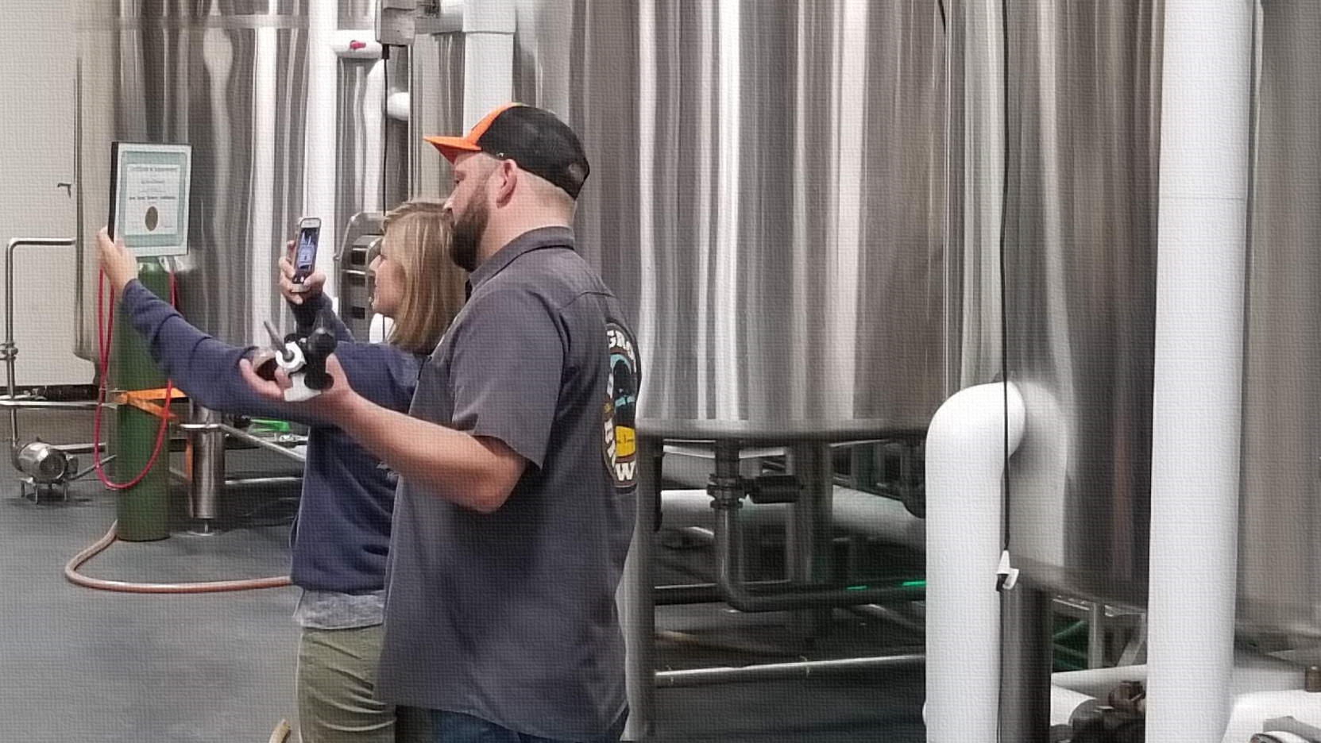

Iowa Green Brewery Certification
Iowa Green Brewery Certification
Joe Bolick – Iowa Waste Reduction Center
University of Northern Iowa

Slide 37
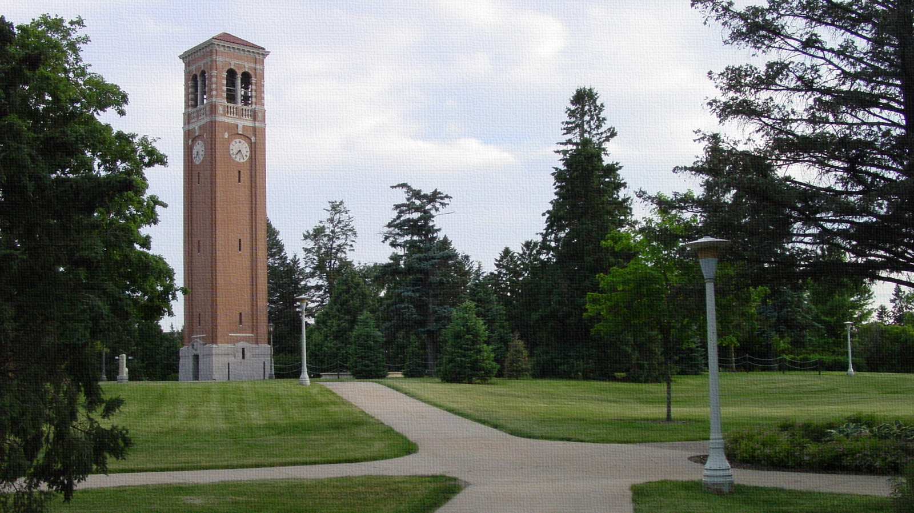
Iowa Waste Reduction Center, What Next?
Iowa Waste Reduction Center
Located at the University of Northern Iowa
Non-Regulatory Compliance Assistance
Painter Training and Education
WHAT NEXT?

Slide 38
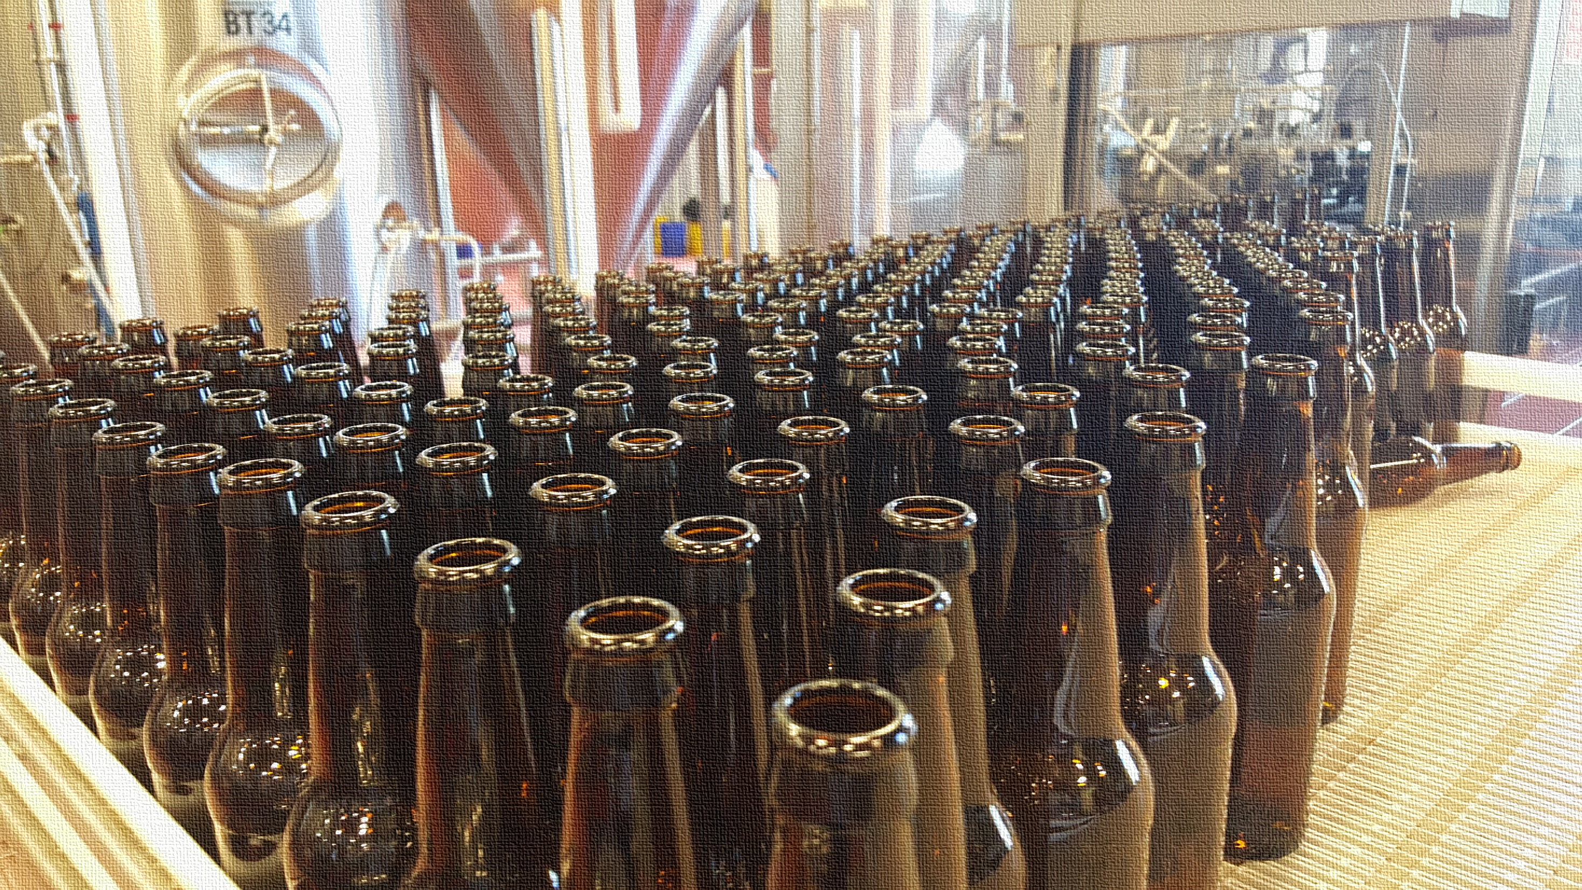

BEER!!!
BEER !!!
Rapid Growth in Iowa
Resource Intensive Processes
It’s beer

Slide 39
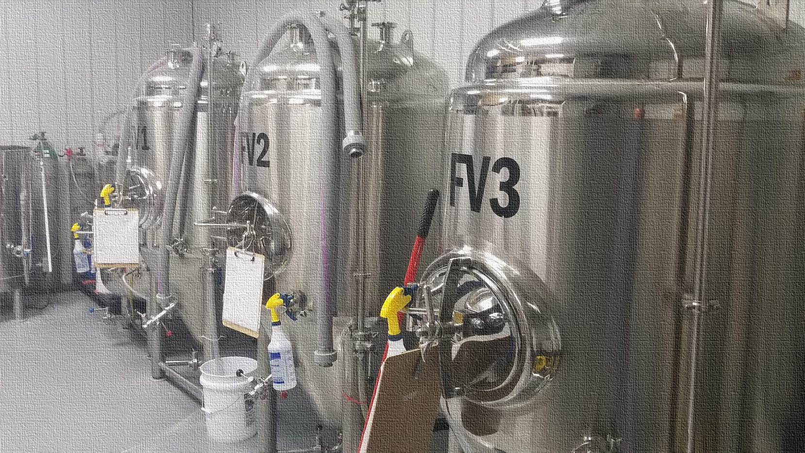
Green Brewery Certification - Getting Started
Getting Started
Surveyed 17 Iowa breweries
Visited 4 of varying sizes
Presented at iBEST
Singlespeed expansion

Slide 40

Green Brewery Certification – Areas of Focus
Areas of Focus
Regulatory assistance
Energy Efficiency
Water Quality & Conservation
Environmental management
Solid waste & inventory control

Slide 41
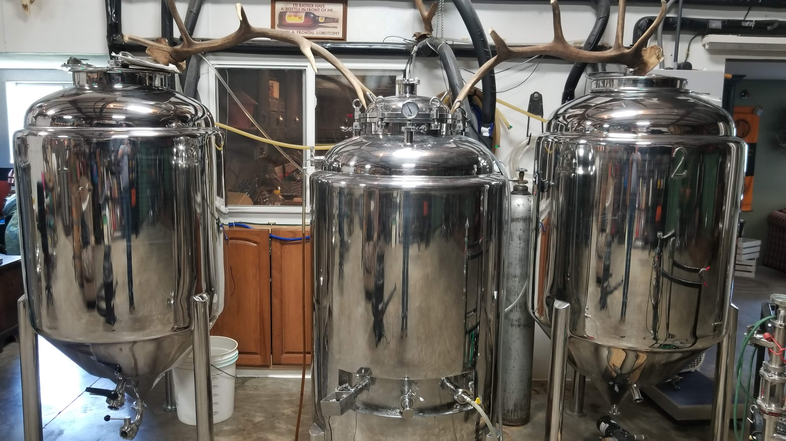
Green Brewery Certification – The Process
The Process
Visit brewery for initial audit
Conduct audit according to checklist
Calculate initial certification score
Create recommendations report based on audit and provide assistance
Certify brewery

Slide 42
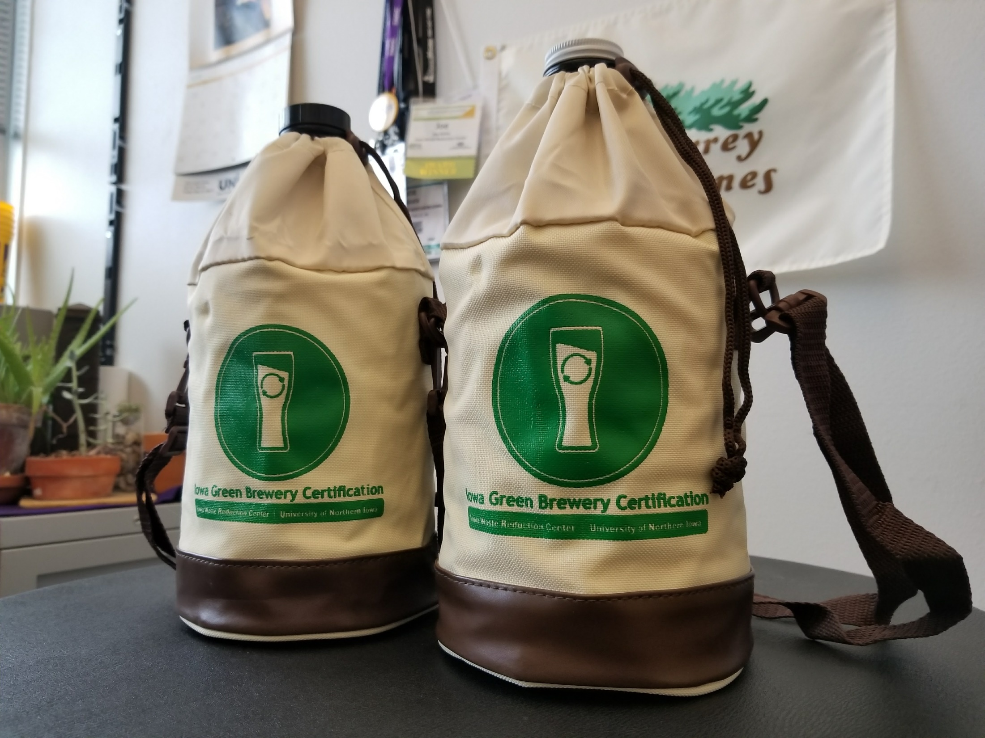
Green Brewery Certification – What’s Included?
What’s included?
Customized environmental recommendations report
Certificate and window cling
Digital button for website
Press release in local area and social media push

Slide 43
Green Brewery Certification – Best Practices
Best Practices
(Cool things we’ve seen)

Slide 44
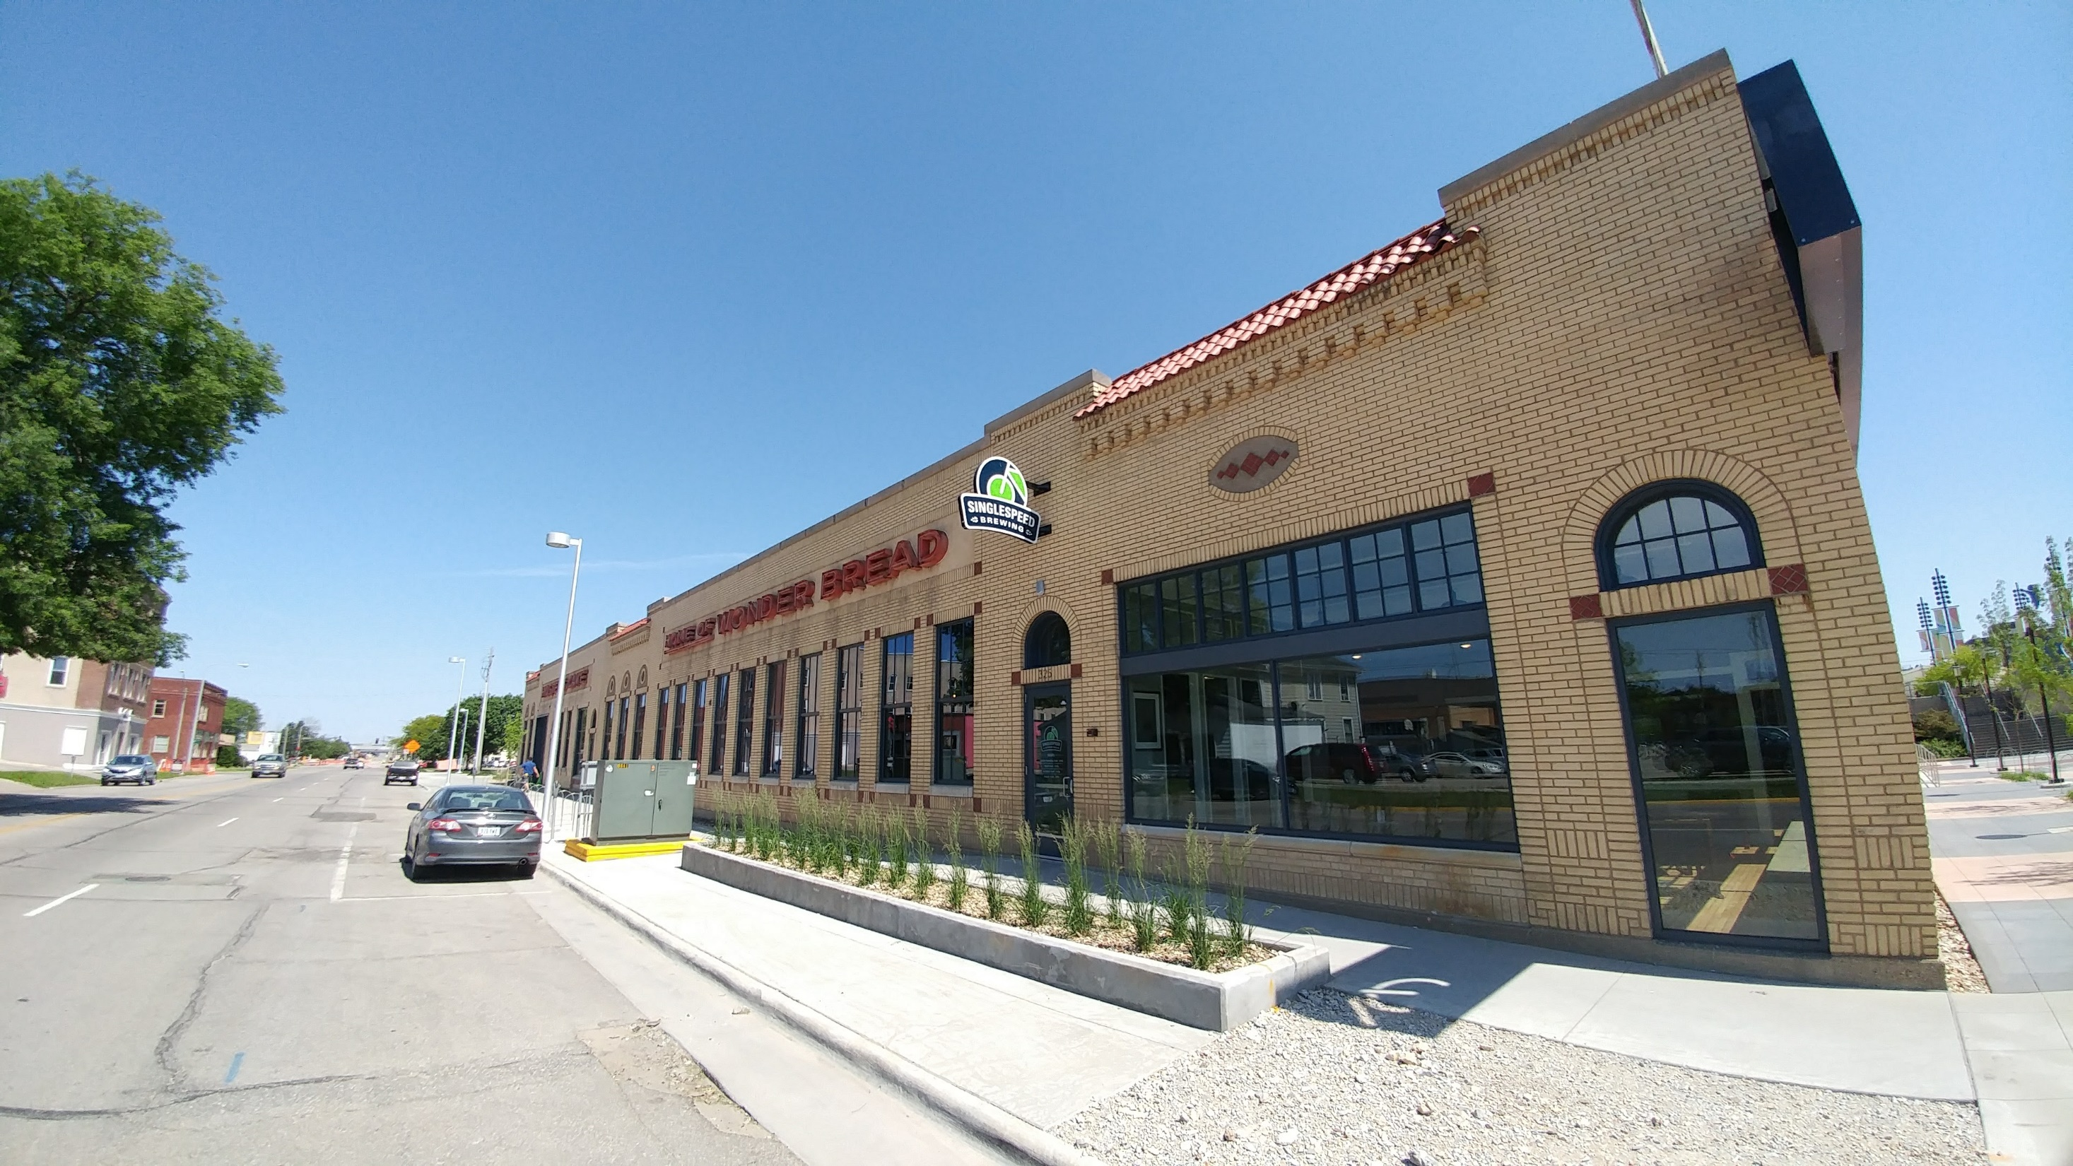
Singlespeed Brewery – slide 1
Singlespeed Brewing
Waterloo

Slide 45
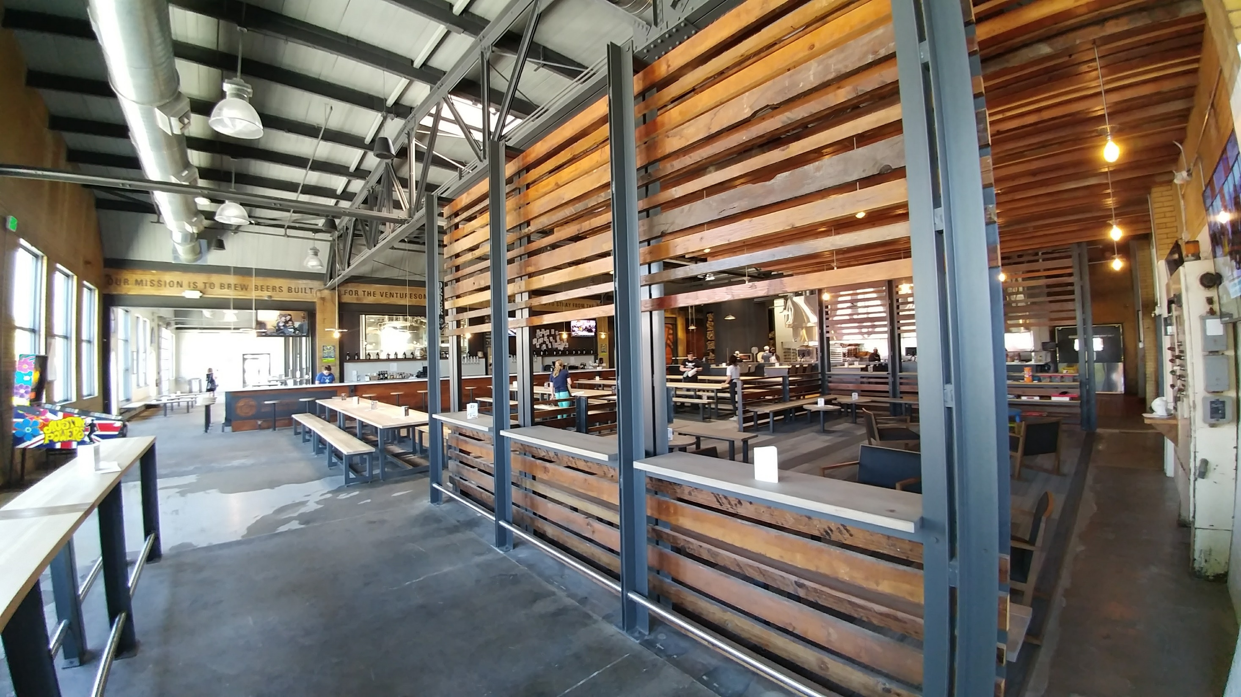
Singlespeed Brewery – slide 2
Singlespeed Brewing
Waterloo

Slide 46
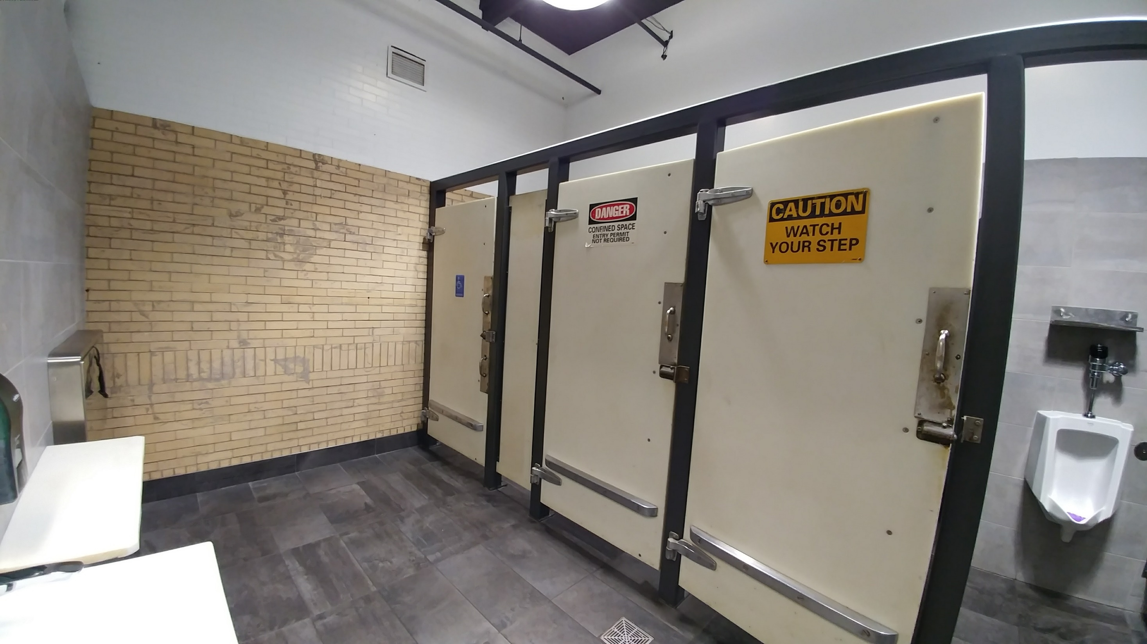
Singlespeed Brewery – slide 3
Singlespeed Brewing
Waterloo

Slide 47
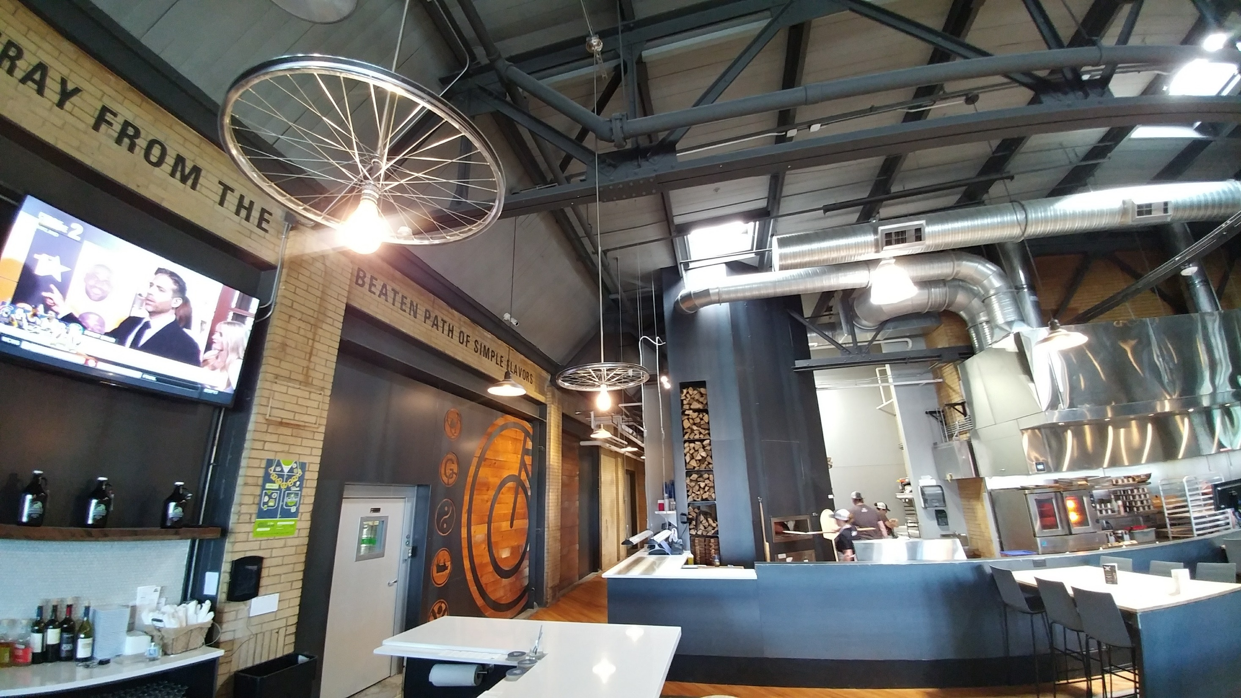
Singlespeed Brewery – slide 4
Singlespeed Brewery – slide
Singlespeed Brewing
Waterloo

Slide 48
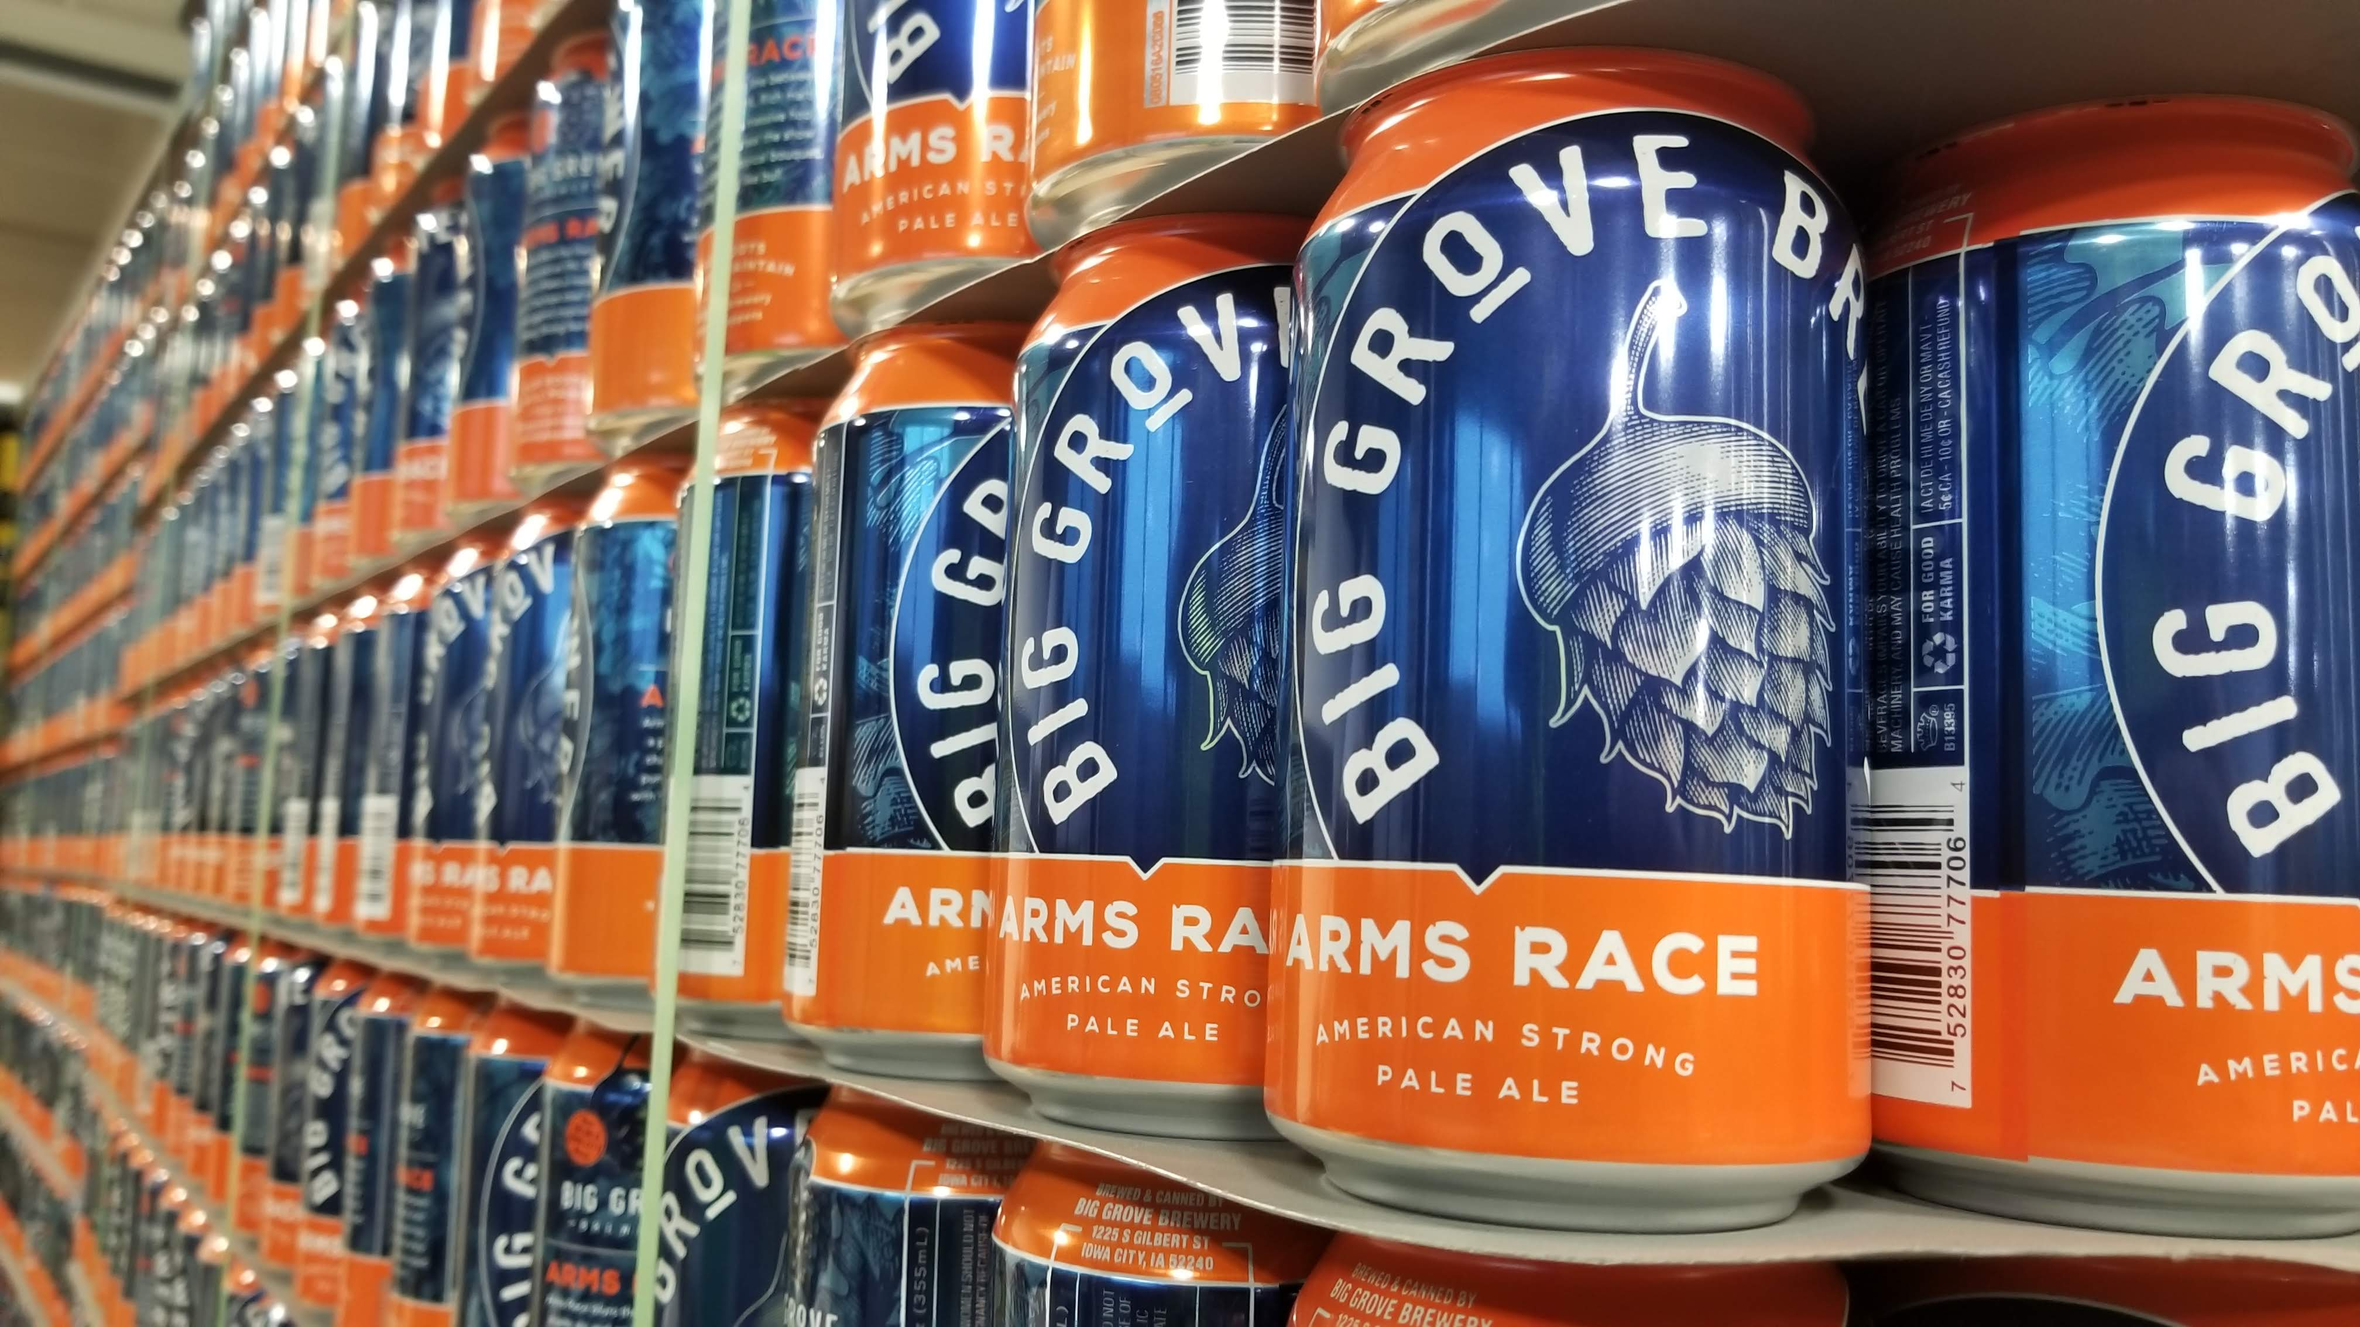
Big Grove Brewery and Taproom – slide 1
Big Grove Brewery & Taproom
Iowa City

Slide 49
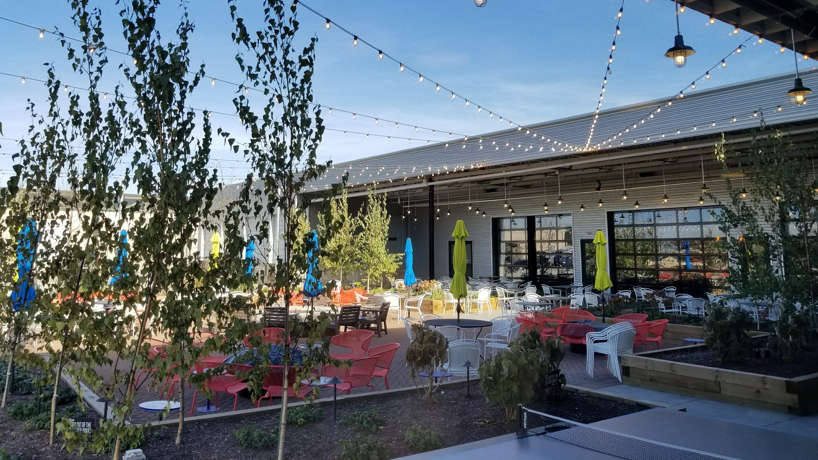
Big Grove Brewery and Taproom – slide 2
Big Grove Brewery & Taproom
Iowa City

Slide 50
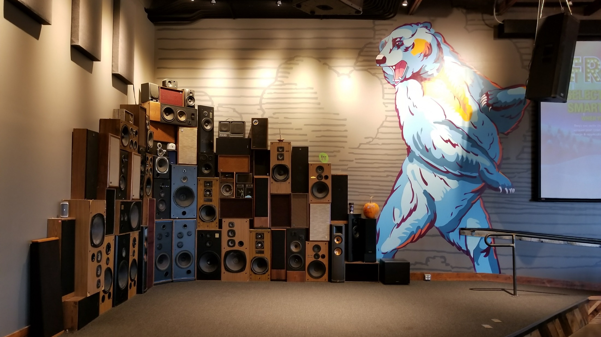
Big Grove Brewery and Taproom – slide 3
Big Grove Brewery & Taproom
Iowa City

Slide 51
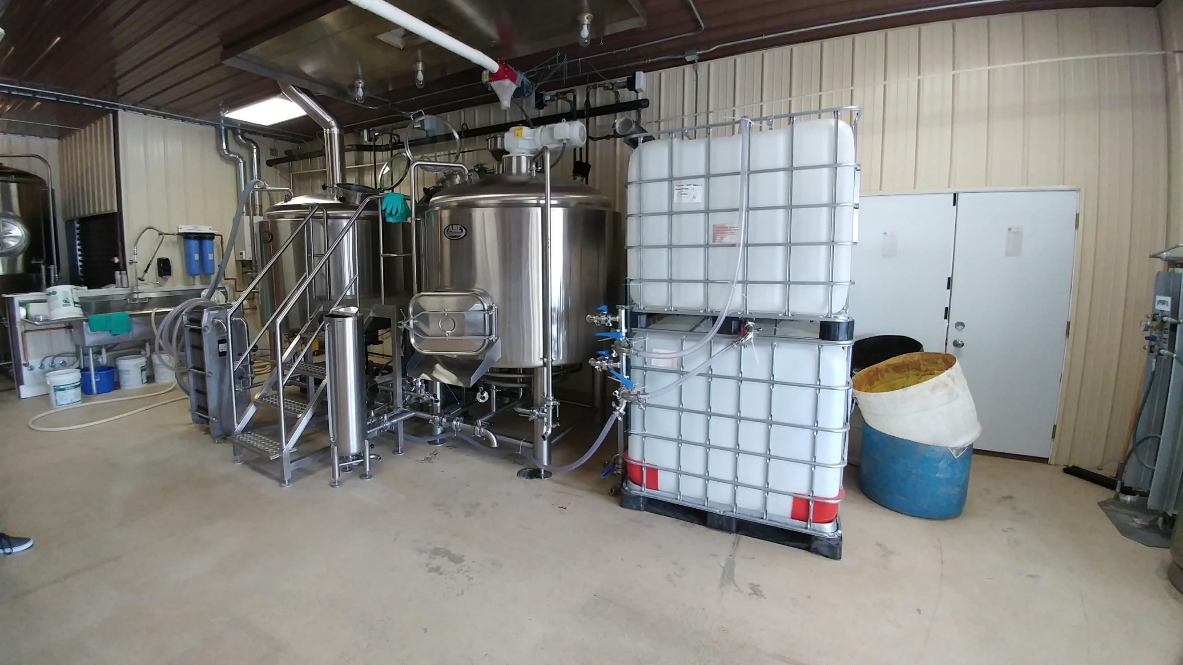
Franklin Street Brewing
Franklin Street Brewing
Manchester

Slide 52
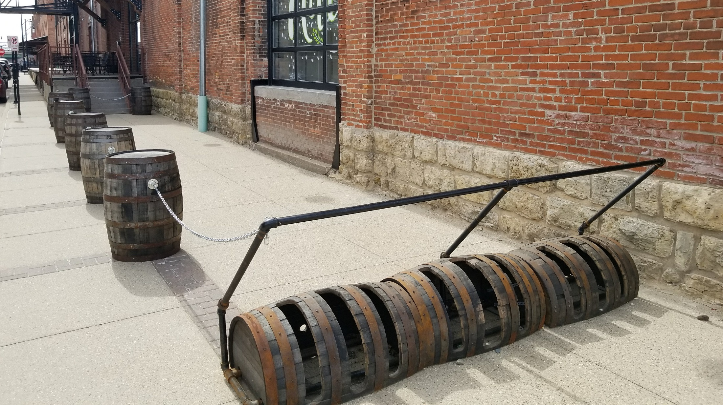
7 Hills Brewing
7 Hills Brewing
Dubuque

Slide 53
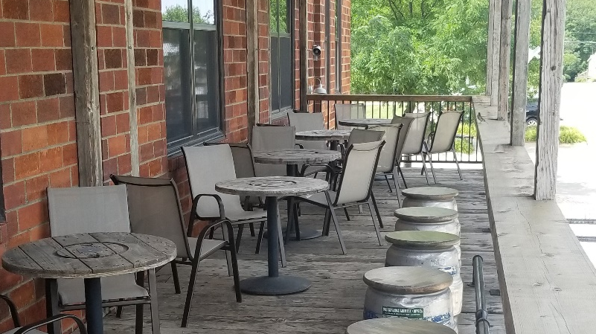
Reclaimed Rails Brewing
Reclaimed Rails Brewing
Bondurant

Slide 54
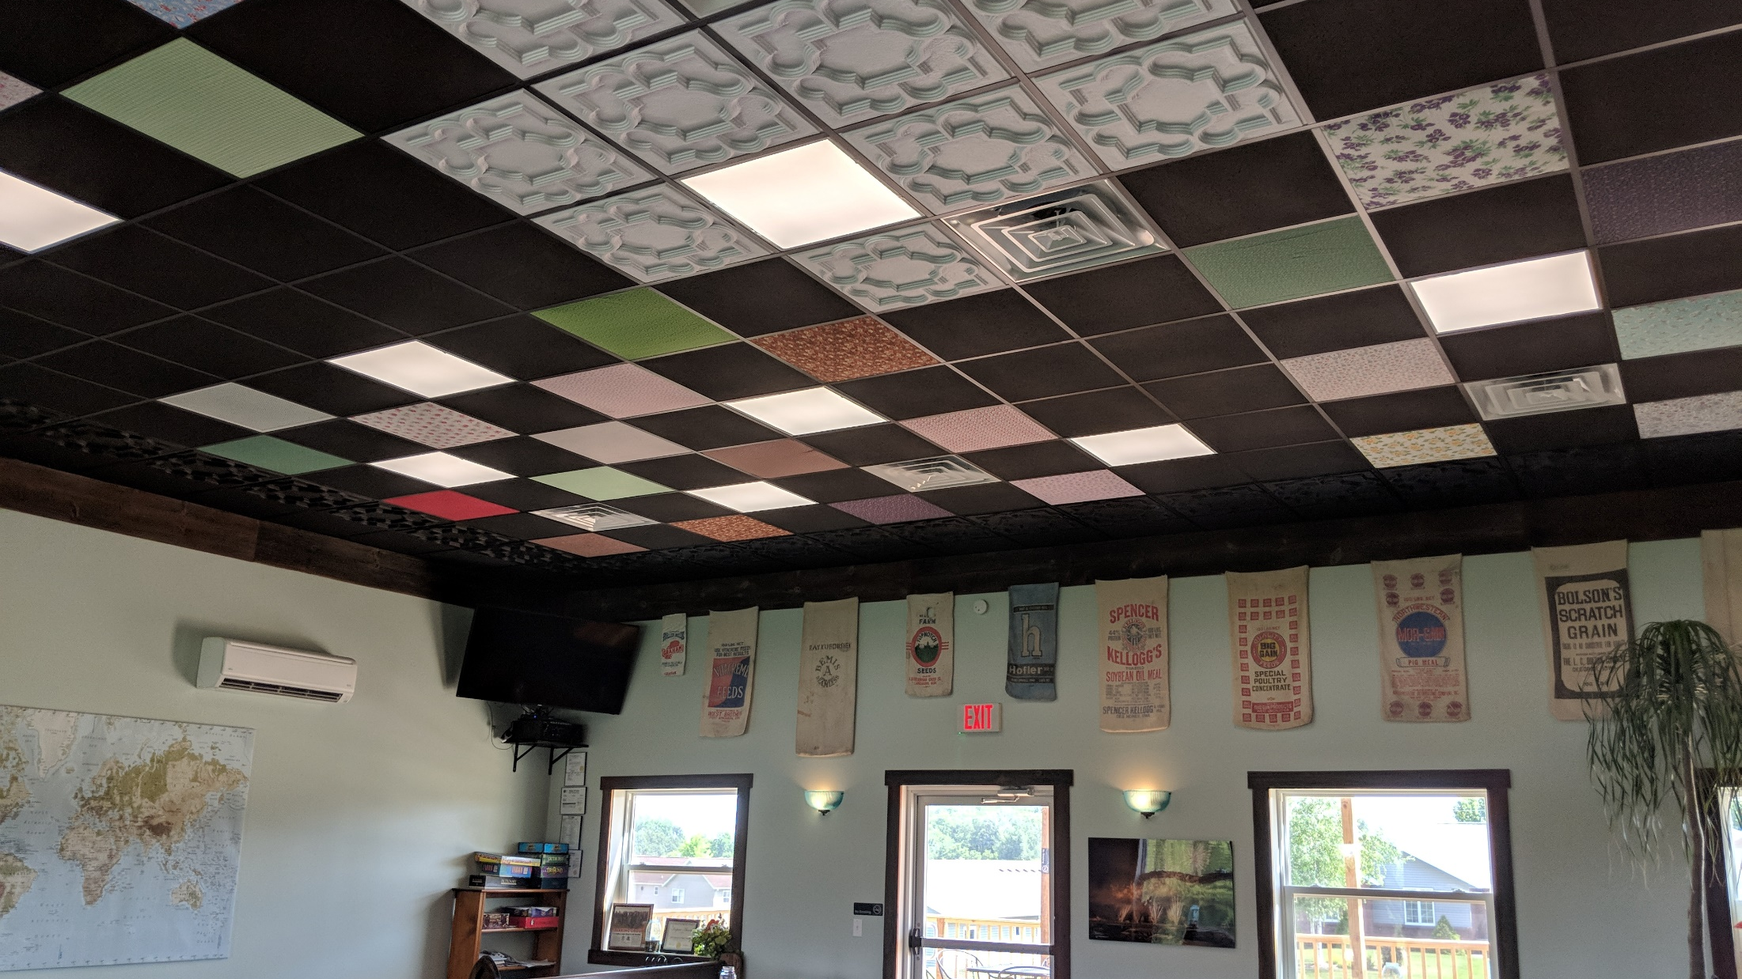
PIVO Brewery
PIVO Brewery
Calmar

Slide 55
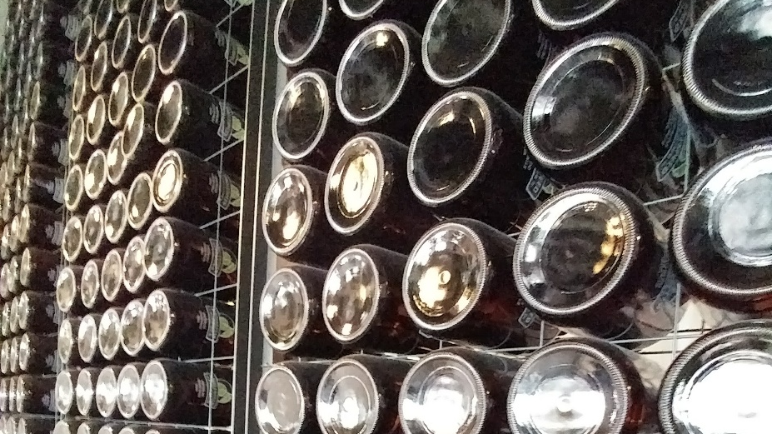
Iowa Green Brewery – Looking Forward
Looking Forward
National Consortium of Environmental Service Providers for Breweries
Other Industry Certification Programs
Content Creation and Development

Slide 56
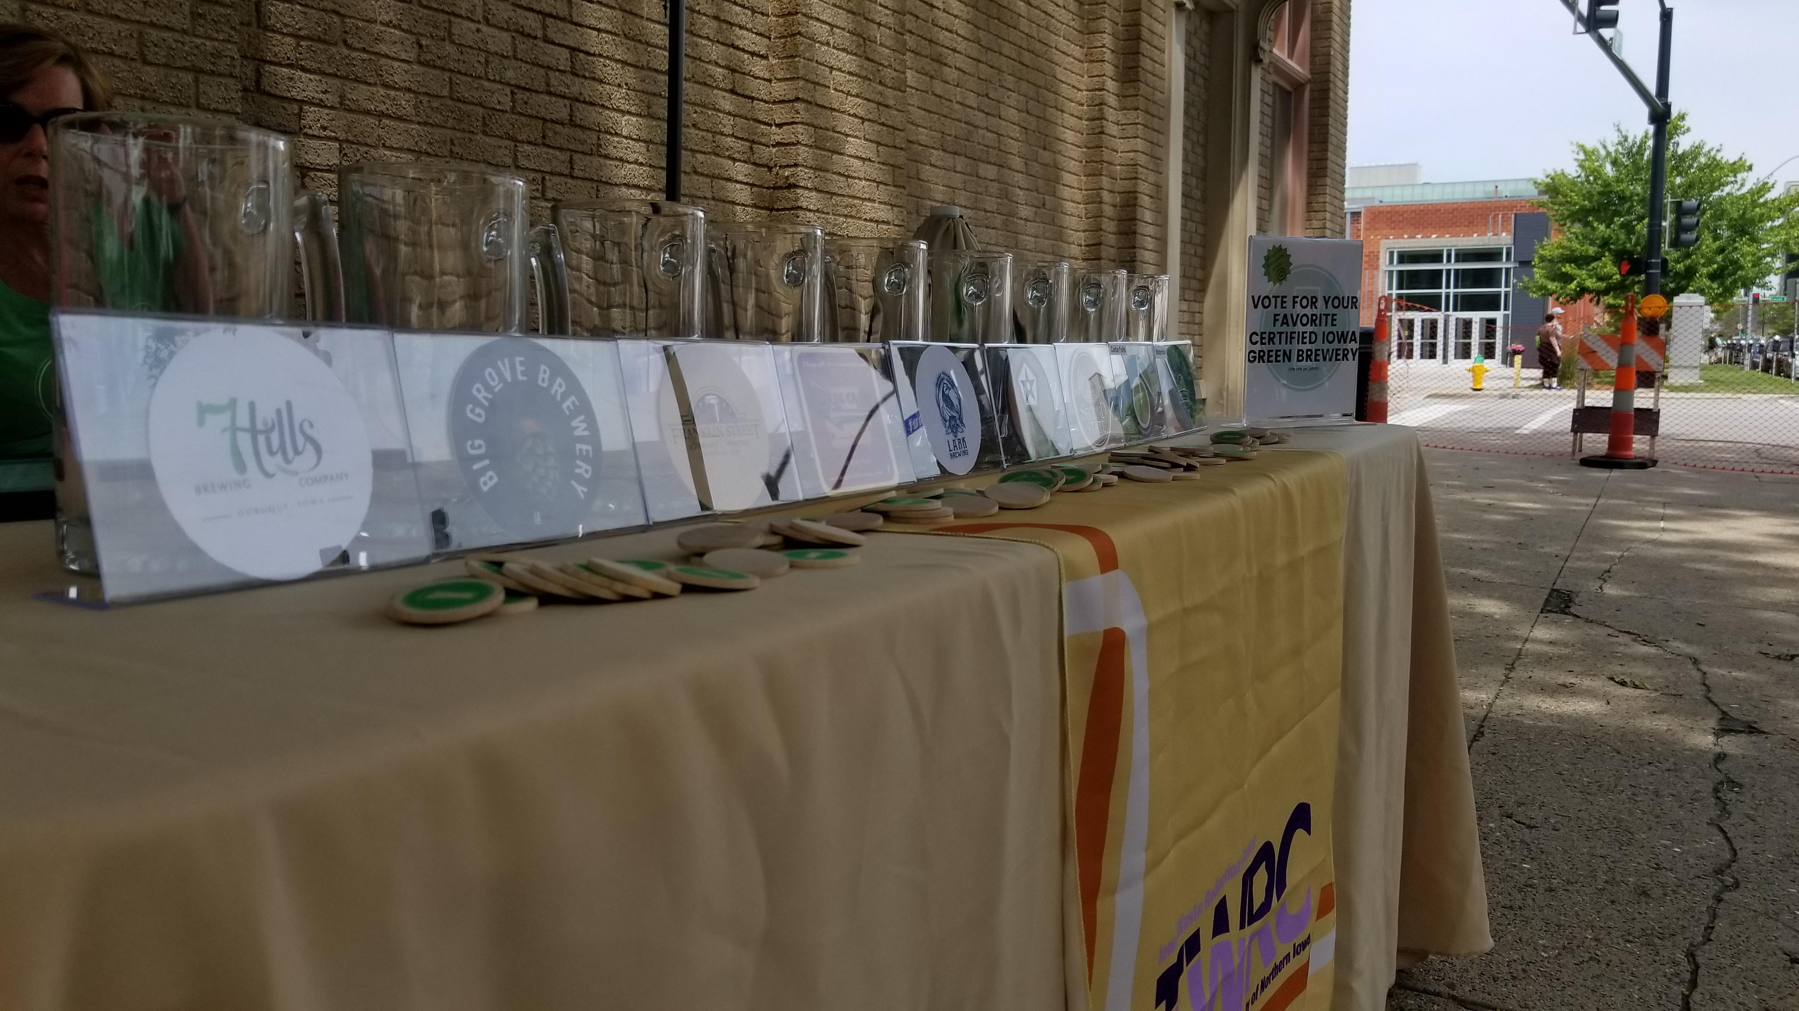

Any questions?
ANY
QUESTIONS?
Joe Bolick
mjbolick@uni.edu
iwrc.uni.edu/green-brewery

Slide 57
Environmental Compliance Training
Occasionally get requests for specific RCRA Training
Training is required in the regulations for LQGs and SQGs
Regardless of regulatory requirement, this type of training is certainly advisable for prudent operation of all facilities
IWRC developing programs to offer such training
First LQG training is being scheduled

Slide 58
Environmental Compliance Training
40 CFR Section 262.17(a)(7) specifically states:
  “Facility personnel must successfully complete a program of classroom instruction, online training (e.g., computer-based or electronic), or on-the-job training that teaches them to perform their duties in a way that ensures compliance with this part…”
Applicable facility personnel include staff who:
  Generate or handle hazardous waste
  Prepare hazardous waste-related records (i.e., manifest, inspection documents, etc.)
  Respond to or manage hazardous waste spills and incidents
  Serve as Emergency Coordinators

Slide 59
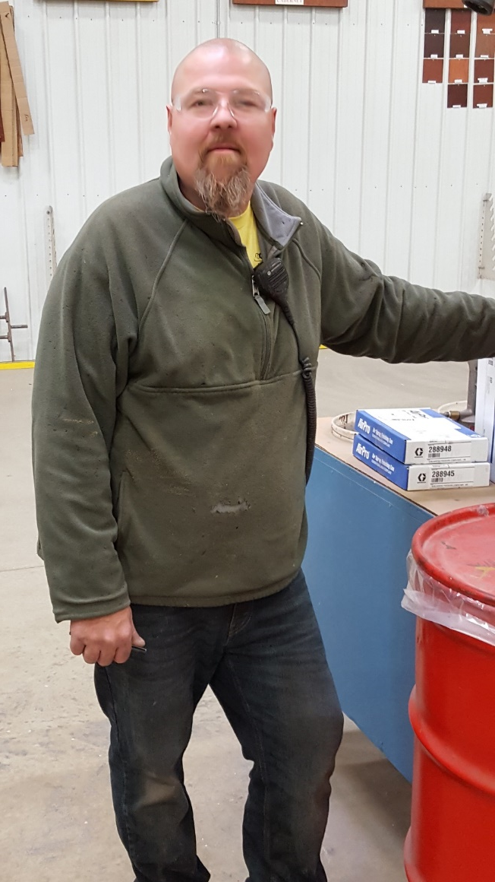
Environmental Compliance Training
Training Objectives
  Familiarize personnel regarding:
    Emergency Response Actions and Contingency Planning
    General hazardous waste management regulations/procedures
  Maintain compliance with applicable Resource Conservation and Recovery Act (RCRA) regulations

Slide 60
Environmental Compliance Training
Example Content
  Many of the plans require some form of notification or emergency agency contact
  This information is appropriately provided on the first page of your A/C booklet
  Familiarize yourself with the nearest location of your A/C booklet and the agencies and contact information within

Slide 61
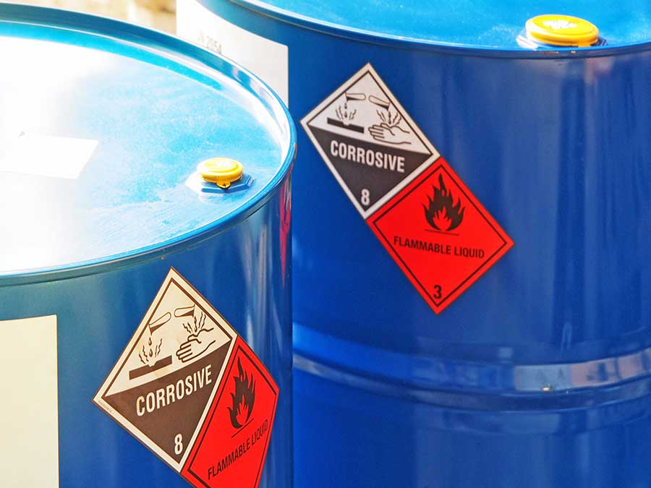
Environmental Compliance Training
Example Content
  Containers must be in good condition
  Compatible with stored material
  Stored in an area near where the waste is generated and under the supervision of the person who generates it
  Individual satellite accumulation areas may not exceed 55 gallons of hazardous waste
  Labeled “Hazardous Waste” and with an indication of the hazard associated with the waste (i.e., ignitable)
  When full (or when 55-gallons have been accumulated), container(s) must be moved to a permanent storage area within 3 days

Slide 62
Upcoming IWRC Activities
Small quantity generator hazardous waste training
EPA dental rule outreach
Storm water training
Food waste activities

Slide 63

Thank you for attending the 2018 IWRC Advisory Committee Meeting!
Thank you for attending the 2018 IWRC Advisory Committee Meeting!

