Slide 1
How to Solve the EV Challenge
EVs are Win-Win-Win
Good for your customers/members
Good for the environment
Good for your bottom line (if you are careful)
Charging
Timing and Level of Charging is Crucial

Slide 2
Notes:
https://www.consumerreports.org/hybrids-evs/evs-offer-big-savings-over-traditional-gas-powered-cars/

Slide 3
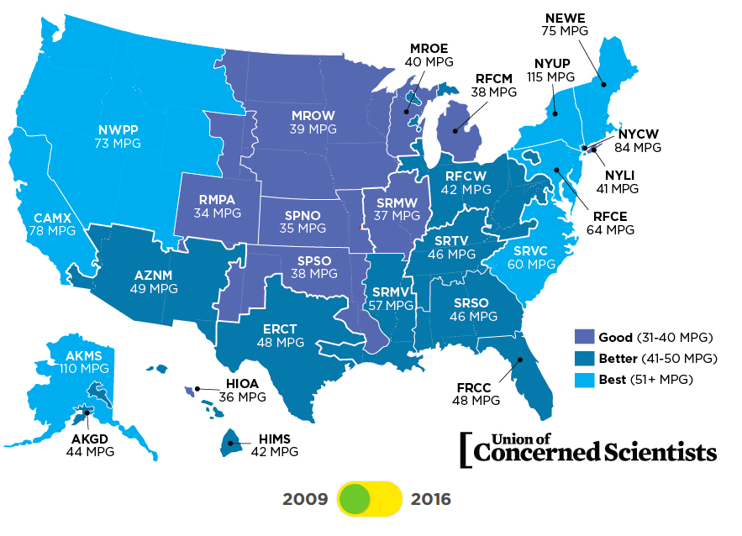

Slide 4
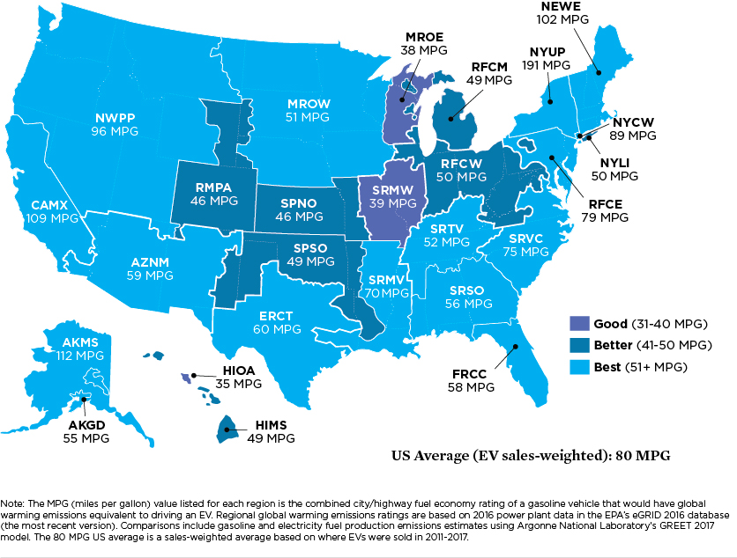
Cleaner over Time
As electricity becomes cleaner, so does your car. Here’s the same map from 2016

Slide 5
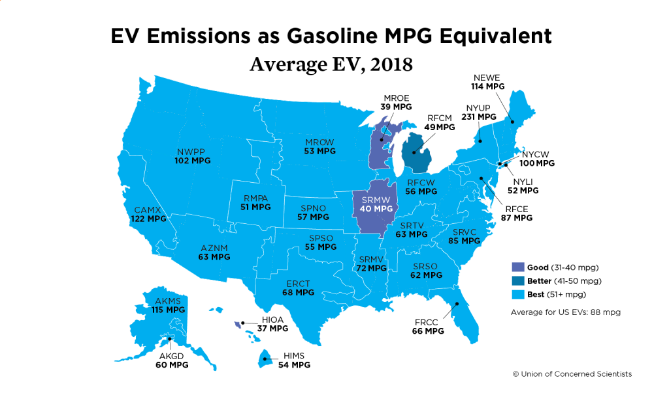

Slide 6
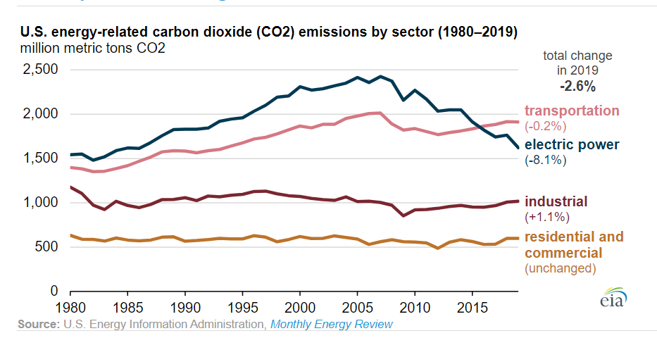
Transportation: US’s Largest Greenhouse Gas Sector, since 2016
Notes:
Crossover point was February 2016, both electricity and transportation account for about 1/3 of US carbon emissions.
FYI, over half of transportation emissions come from gasoline
https://www.eia.gov/todayinenergy/detail.php?id=45836#

Slide 7
A Win* for the Utility
*pending
The timing and level of EV charging is very important
High amounts of EV charging at system peak is problematic
Good News: Most charging is and will be done at home
It’s easy to make sure this happens at night (send a market signal)
Level 2 Chargers can provide 50+ miles of charging overnight

