Slide 1
2024-2028 Energy Efficiency and Demand Response Plan
Erin Rasmussen
Director, Energy Efficiency

Slide 2
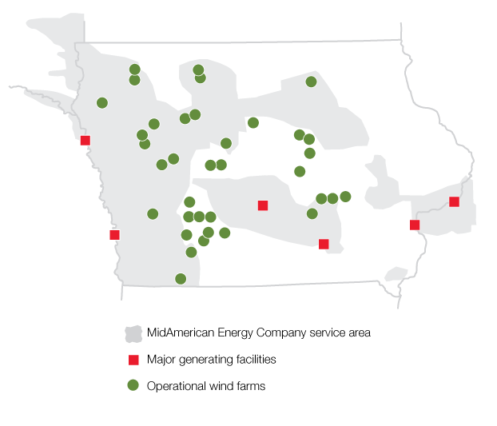
MidAmerican Energy Overview
Headquartered in Des Moines, Iowa
1.6 million electric and natural gas customers in Iowa, Illinois, South Dakota and Nebraska
11,731 MW⁽¹⁾ of owned capacity (7,320 MW of wind and 141 MW of grid-scale solar)
Owned capacity by fuel type:
  12/31/22⁽¹⁾ 12/31/00
  Wind and Solar⁽²⁾ 62% 0%
  Coal 22% 70%
  Natural gas 11% 19%
  Nuclear and other 5% 11%
⁽¹⁾ Net MW owned in operation and under construction as of December 31, 2022
⁽²⁾ All or some of the renewable energy attributes associated with generation from these generating facilities may be: (a) used in future years to comply with renewable portfolio standards or other regulatory requirements or (b) sold to third parties in the form of renewable energy credits or other environmental commodities
Notes:
Headquartered in DSM
1.6M elec and natural gas customers in Iowa, Illinois, SD, NE
Large wind portfolio –map shows our service territory shaded in grey and our generating facilities and wind farms

Slide 3
Programs Overview
Residential
Residential Equipment
Nonresidential
Nonresidential Equipment
Multi-Sector / Other
Education
Demand Response
Residential Load Management
Residential Assessment
Residential Behavioral
Residential Appliance Recycling
Residential Low Income
Nonresidential Energy Solutions
Commercial New Construction
Nonresidential Low Income
Trees
Nonresidential Load Management
Notes:
As you can see, today, in Iowa we have a variety of programs for all customer sectors at a reasonable cost.
In the new plan, we are not proposing any new programs. However, we are proposing to enhancing the majority of these existing programs by adding new measures, incentives and service options.
The goals for this plan are to: Improve customer experience; focus on low and underserved communities and offer a mix of measures and programs to fit all customer types.
For the next few minutes, I will focus on the enhancements that we have proposed. For more information on all our energy efficiency programs, please visit our website at www.midamericanenergy.com/ee.

Slide 4
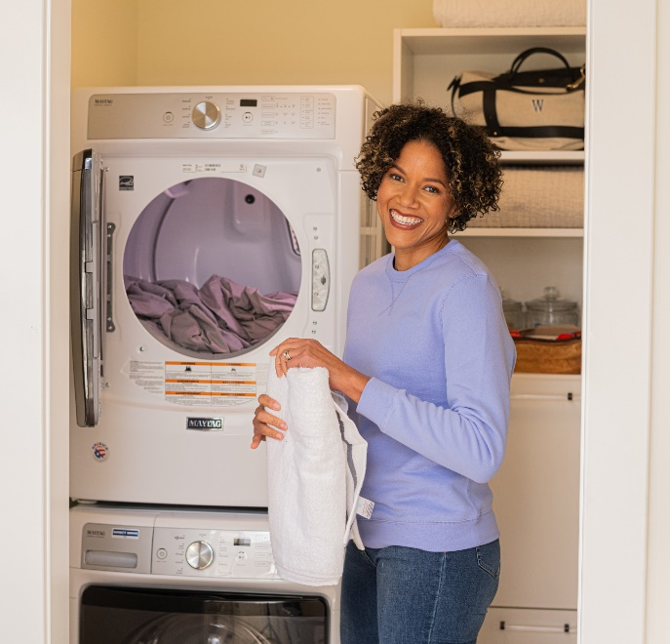
Residential Equipment
New incentive delivery models
  Midstream (pilot 2023)
  Online marketplace
  Retail
New measures
  Ground source heat pumps
  HVAC tune-ups
  Heat pump water heaters
  ENERGY STAR® appliances
Notes:
Our well-known residential equipment program incentivizes residential customers to purchase and install new, energy-efficient equipment.
The major changes to this program are the introduction of new incentive delivery models, one of which we have just launched as a pilot.
In a midstream model, the incentive is given to the equipment distributor to encourage them to stock energy-efficient equipment.
The distributor passes those savings down to the customer in the form of an instant discount at the time of sale.
MidAmerican and Alliant have just launched a pilot midstream program marketed as Instant Discounts.
The other models include an online marketplace and retail.
The goal is to make it easy for the customer and reduce the cost of the equipment at time of sale.
Some new residential measures that you will see in this plan are GSHP, HVAC tune-ups, heat pump water heaters, and energy star appliances

Slide 5

Residential Low Income
Statewide Weatherization
  Increased funding ($2M/year)
  Support contractor training/certification
Supplemental Weatherization
  Weatherization kits
  Food bank
  CAP partnerships
  Community engagement
Notes:
We will continue our relationship with Iowa Department of Human Rights and will increase our annual support to $2M/year.
A part of this funding will also be used to help IDHR certify contractors to perform services for the weatherization assistance program.
This is a current and continuing challenge they are facing and we are committed to helping them get more contractors certified so that more homes can be weatherized.
We will also be continuing our supplemental weatherization program which will include a variety of opportunities like kits, food bank giveaways, and community and agency partnerships

Slide 6
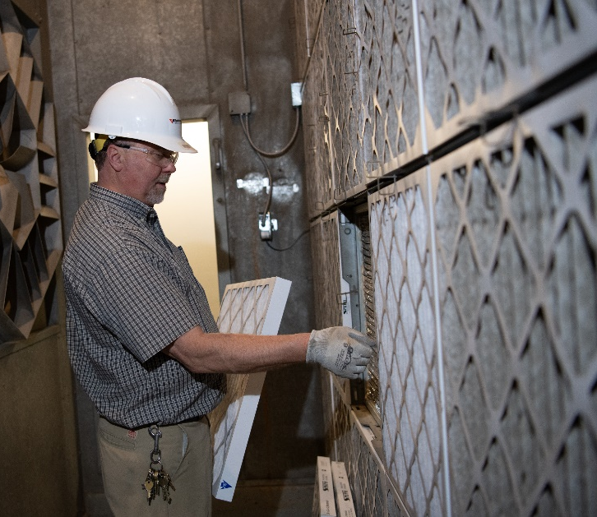
Nonresidential Equipment
Incentive delivery models
  Midstream (pilot 2023)
  Prescriptive
New measures
  Ground source heat pumps
  HVAC tune-ups
  Commercial kitchen equipment
Notes:
Similar to Residential Equipment, in the nonresidential equipment program we will also be moving more products to midstream in this new plan and adding GSHP, HVAC tune-ups and commercial kitchen equipment.

Slide 7
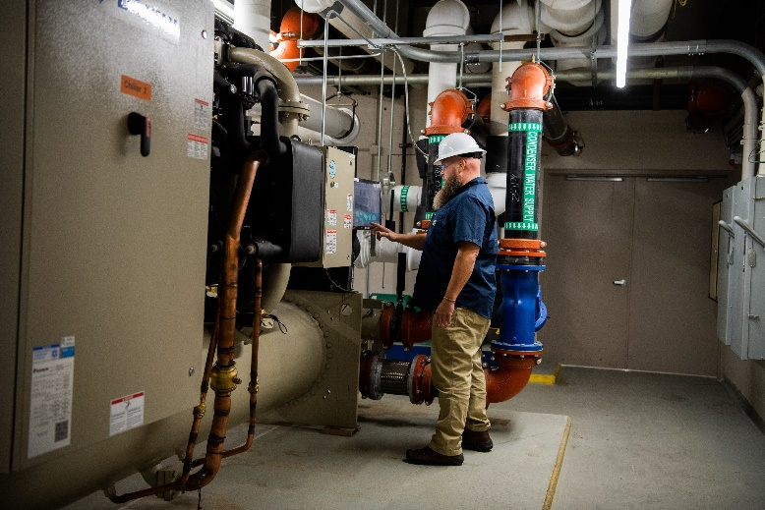
Nonresidential Energy Solutions
Comprehensive energy efficiency for existing commercial buildings and industrial facilities
Four components:
  Small Business Express
  Direct Project Assistance
    Facility assessments
  Retro-Commissioning (NEW)
  Strategic Energy Management (NEW)
Notes:
The Nonresidential Energy Solutions program will add 2 new offerings: RCx and SEM
The Retro-commissioning (RCx) component is targeted at large commercial and industrial facilities to improve how equipment and systems function together in existing buildings.
Strategic Energy Management (SEM) will assist organizations to implement energy management business practices that take a holistic approach to managing energy use to continuously improve energy performance through steady savings over time.

Slide 8
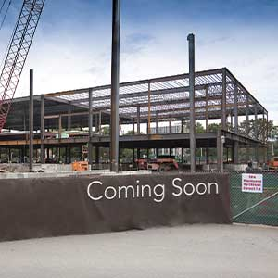
Commercial New Construction
Natural gas incentives
Adding new services
  Streamlined
  Enhanced
Continuing services
  Standard
  Multifamily
  Volume build
  Data Center
Notes:
The Commercial New Construction program will be adding gas incentives back into the program as well as two new services: Streamlined and Enhanced.
Streamlined Service: Targets smaller buildings that want a streamlined process.
Enhanced Service: Targets projects with aggressive energy efficiency goals – typically energy savings of 40 percent or greater.

Slide 9
Nonresidential Low Income
Three components:
  Income Qualified Multifamily Housing
  Affordable Multifamily New Construction (NEW)
    Enhanced incentives
    Participate in Iowa Finance Authority (IFA) Housing Tax Credit Program or National Housing Trust Fund
  Income Qualified Small Business (NEW)
    Qualified Census Tract, National Opportunity Zone or other community identified as low income or underserved by MidAmerican
    Retail spaces, restaurants and other community-centric businesses less than 10,000 sf
    National accounts or chains not eligible
    Enhanced incentives
Notes:
The nonresidential low income program will add a new affordable multifamily new construction offering with enhanced incentives for properties that participate in IFA’s Housing Tax Credit Program or in the National Housing Trust Fund.
We are also excited to offer an enhanced small biz express offering to small businesses in qualified census tracts or national opportunity zones. We will target retail, restaurants and other community centric businesses.

Slide 10
Demand Response
Residential Load Management
  Increased incentive for smart thermostat participation = $40/season
  All new participation – smart thermostat only
  Maintain existing LCRs, but no replacements/new installs
Nonresidential Load Management
  Minimum curtailable load lowered to 200 kW
  Two participation options:
    Summer only (June 1-Sept 30)
    Year-round (June 1-May 31)
  Updated incentives based on participation
    Summer only = $30/kW
    Year-round = $60/kW
Notes:
Residential Load Management, marketed to customers as the SummerSaver program, customers will receive $40 for participation with a smart thermostat, to further incentivize smart thermostat participation.
For Nonresidential Load Management, or Curtailment), we are decreasing the kW minimum and offering 2 options – summer only and year-round.

Slide 11
Budget and Savings
Budget
  Electric energy efficiency:
    $41.5M in 2024 increasing to $47M by 2028
  Gas energy efficiency:
    $6.6M in 2024 increasing to $7.3M in 2028
  Electric demand response:
    $19.2M in 2024 increasing to $20M in 2028
Savings
  Electric incremental savings:
    208K MWh in 2024 increasing to 224K MWh by 2028
    380 MW in 2024 increasing to 433 MW by 2028
  Gas incremental savings:
    1.7M therms in 2024 increasing to 1.8M therms by 2028
    4,778 peak therms in 2024 increasing to 6,147 peak therms in 2028
Notes:
Quick overview of the proposed budget and savings.

Slide 12
MidAmerican Energy Company

