Slide 1
2023 Energy Trends Workshop
Building a sustainable and reliable grid

Slide 2
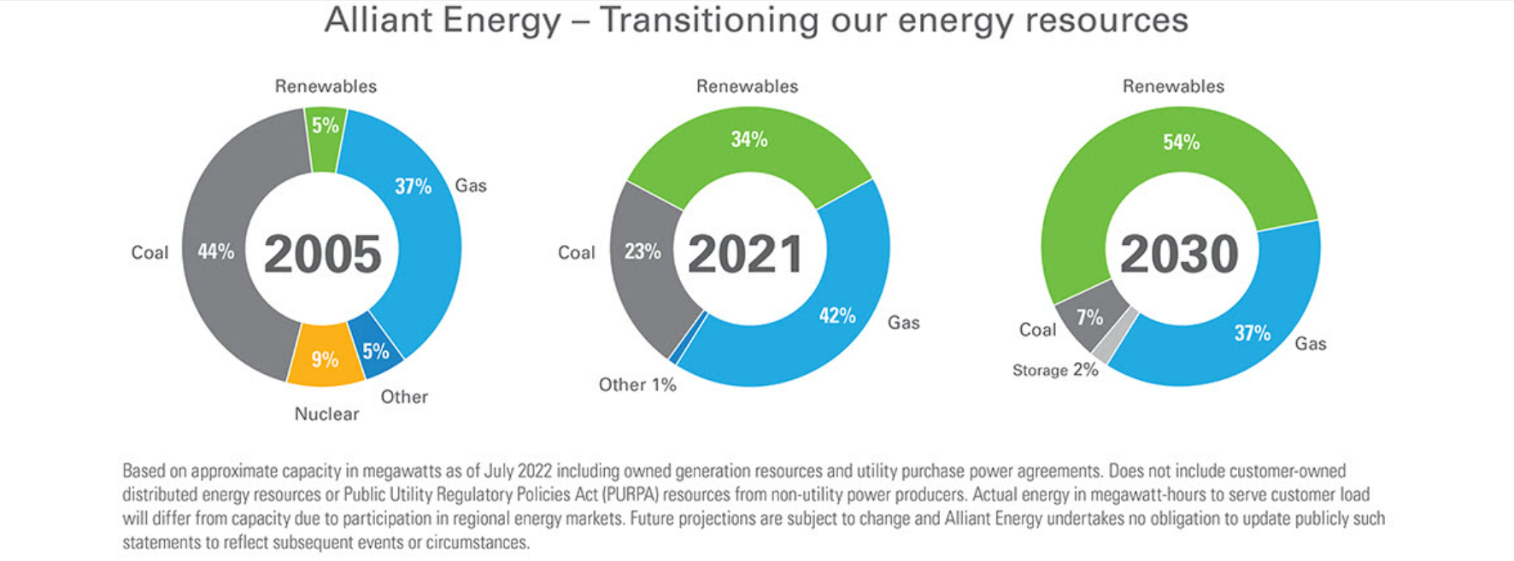
Build a Sustainable Grid

Slide 3
Build a Reliable Grid: 25kV
4kV
12.5kV
25kV
Enhances bi-directional flow with renewable energy
More load over longer distances = fewer substations
Network circuits = more redundancy

Slide 4
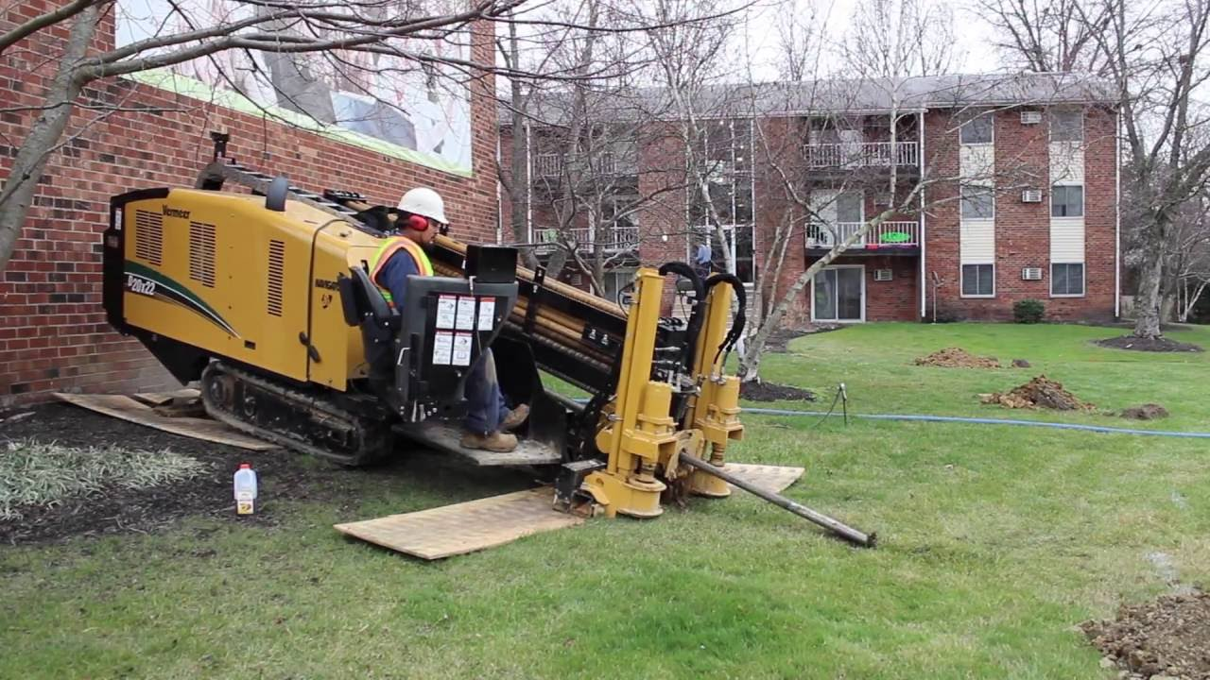
Build a Reliable Grid: Underground
20,000 miles of powerlines in Iowa
More people are working from home = reliability is more and more critical
Undergound Powerlines are 6x more reliable!

