Slide 1
EV Charging impacts IEC grant to ISU Mining Smart Meter Data for Modeling and Mitigating EV Charging Impacts on Distribution Grids Anne Kimber, akimber@iastate.edu
“Goal is to help guide beneficial distribution grid investment using new machine learning techniques based on real utility smart meter data to predict EV impacts. We will package these tools into an open-source software available for utilities.
Quantify and model impacts of EV charging on power grids, and design optimal mitigation strategies to help utilities accommodate the increasing penetration of EVs.
Use advanced machine learning, time-series power flow, and real AMI data to consider various types of EVs, chargers, climates, customer demands, and revenue models.
Package results as an open-source tool to help utilities analyze AMI data and EV charging impacts.

Slide 2
Charging impacts challenges:
Customer charging behavior profiles (when, how long, “pure EV” charging load) not simple.
Cold weather battery heating (especially for fast charging) may be a significant load
Sizing distribution transformers for neighborhoods with EVs is complicated set of investment decisions
Supply chain delays add complexity
In general, we don’t know how well we can manage EV charging through time of use rates. How price-responsive are these loads?
Big unknown: Forecasting the rate of new EV purchases over the next 5 years, but need to invest in infrastructure now.
Charging impacts study help:
Utility partners are providing AMI data, distribution system models, and their experiences with TOU rates and observations on transformer loading patterns.
Some utilities have EV metering
We are also starting to get data from Iowa EV owners (e.g. Iowa EV Owners group, Davenport Tesla Owners)
We have recent research to be able to estimate cold weather charging impacts

Slide 3
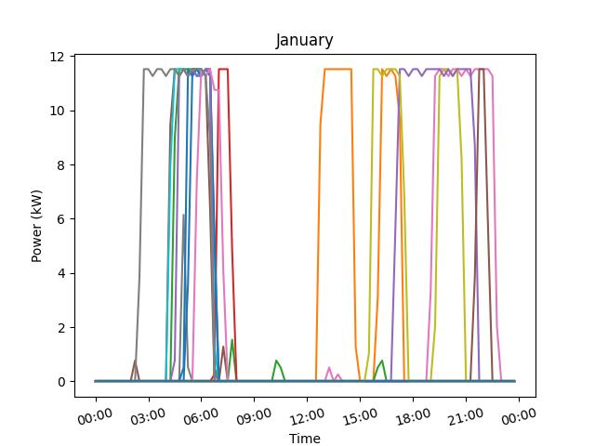
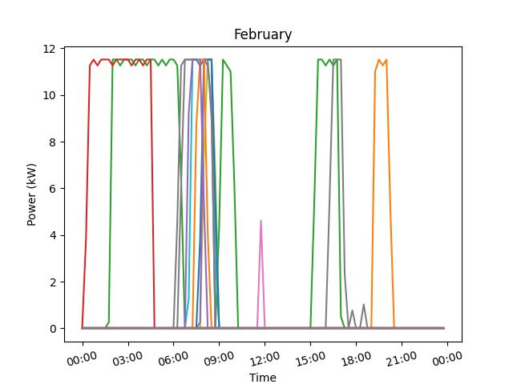
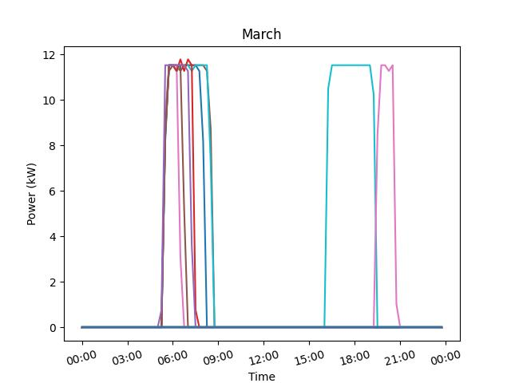
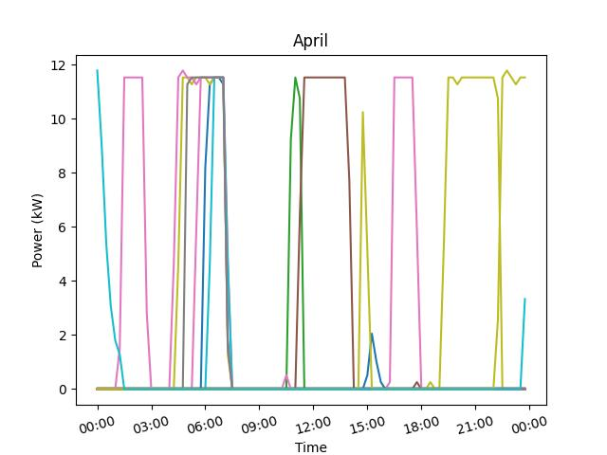
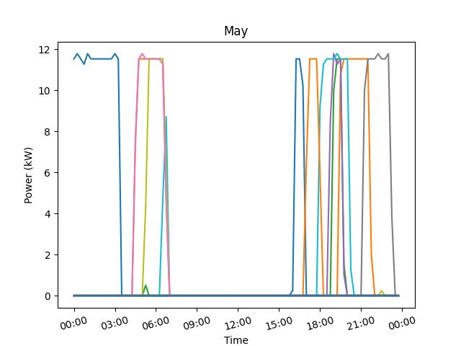
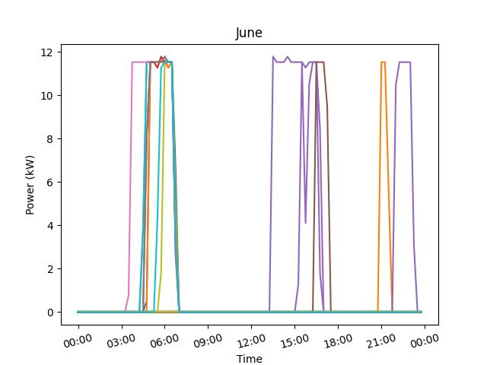
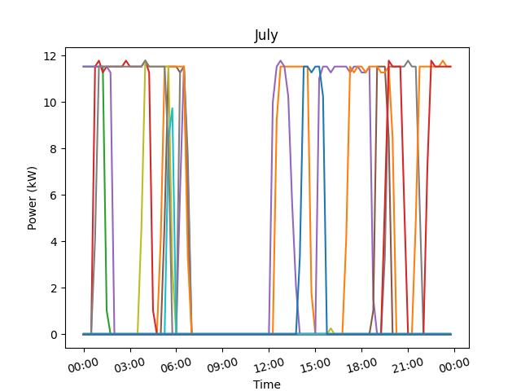
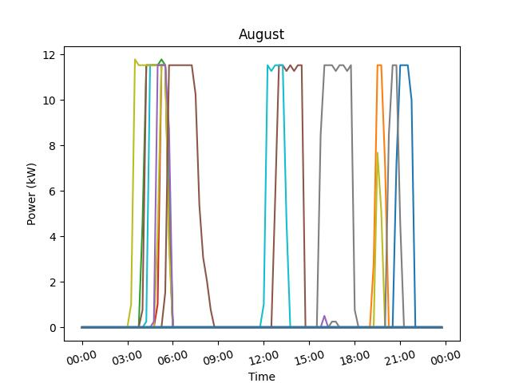
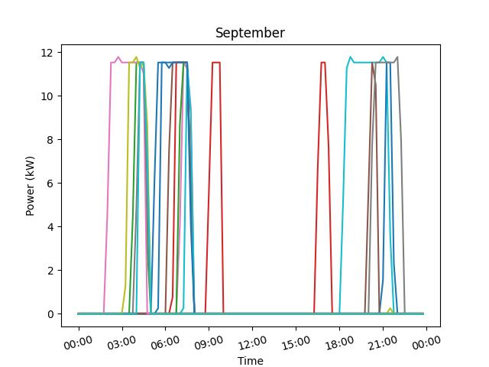
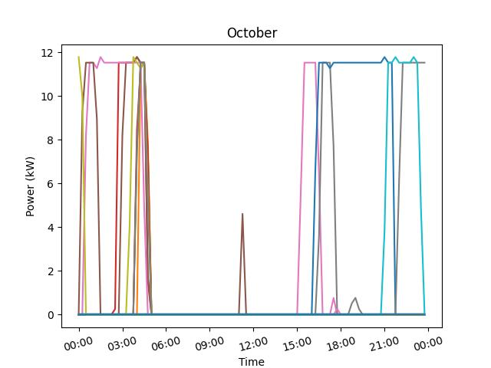
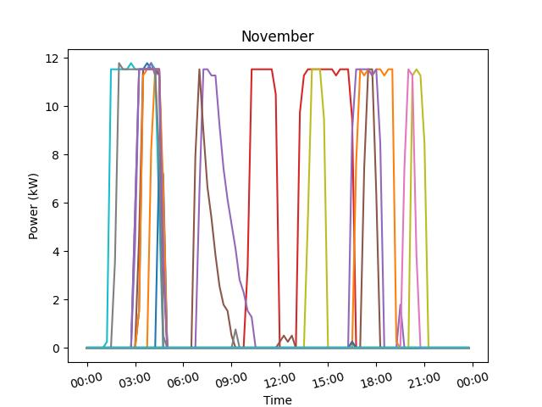
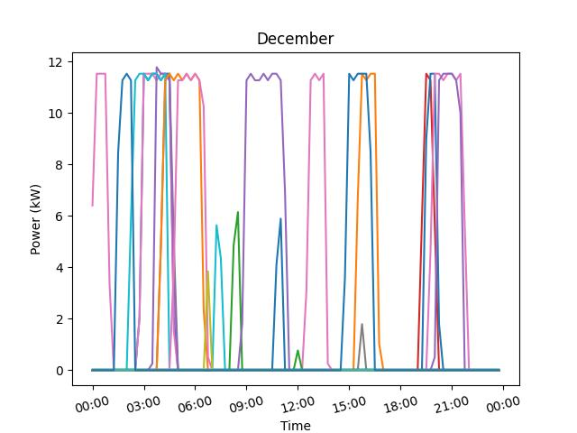
EV Charging Pattern of Residential Customers In 2022
Data source: Iowa utility.
Pure EV charging data
We plan to extract the charging behavior of customers according to variables such as workday, weekend, public holidays, and weather.

