Slide 1
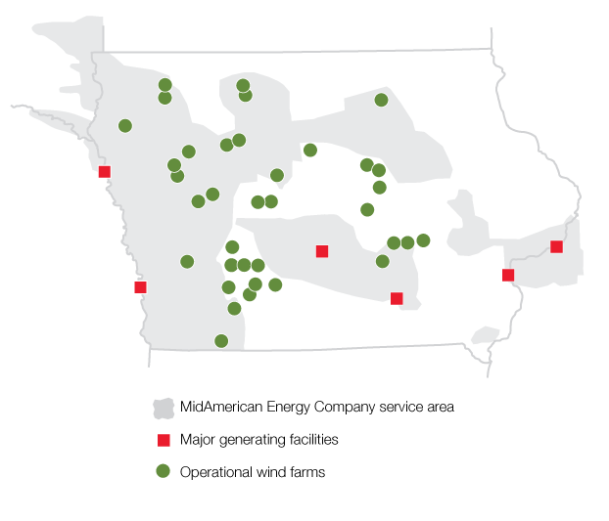
MidAmerican Energy Overview
Headquartered in Des Moines, Iowa
1.6 million electric and natural gas customers in Iowa, Illinois, South Dakota and Nebraska
11,731 MW⁽¹⁾ of owned capacity (7,320 MW of wind and 141 MW of grid-scale solar)
Owned capacity by fuel type:
  12/31/22⁽¹⁾ 12/31/00
  Wind and Solar⁽²⁾ 62% 0%
  Coal 22% 70%
  Natural gas 11% 19%
  Nuclear and other 5% 11%
⁽¹⁾ Net MW owned in operation and under construction as of December 31, 2022
⁽²⁾ All or some of the renewable energy attributes associated with generation from these generating facilities may be: (a) used in future years to comply with renewable portfolio standards or other regulatory requirements or (b) sold to third parties in the form of renewable energy credits or other environmental commodities

Slide 2
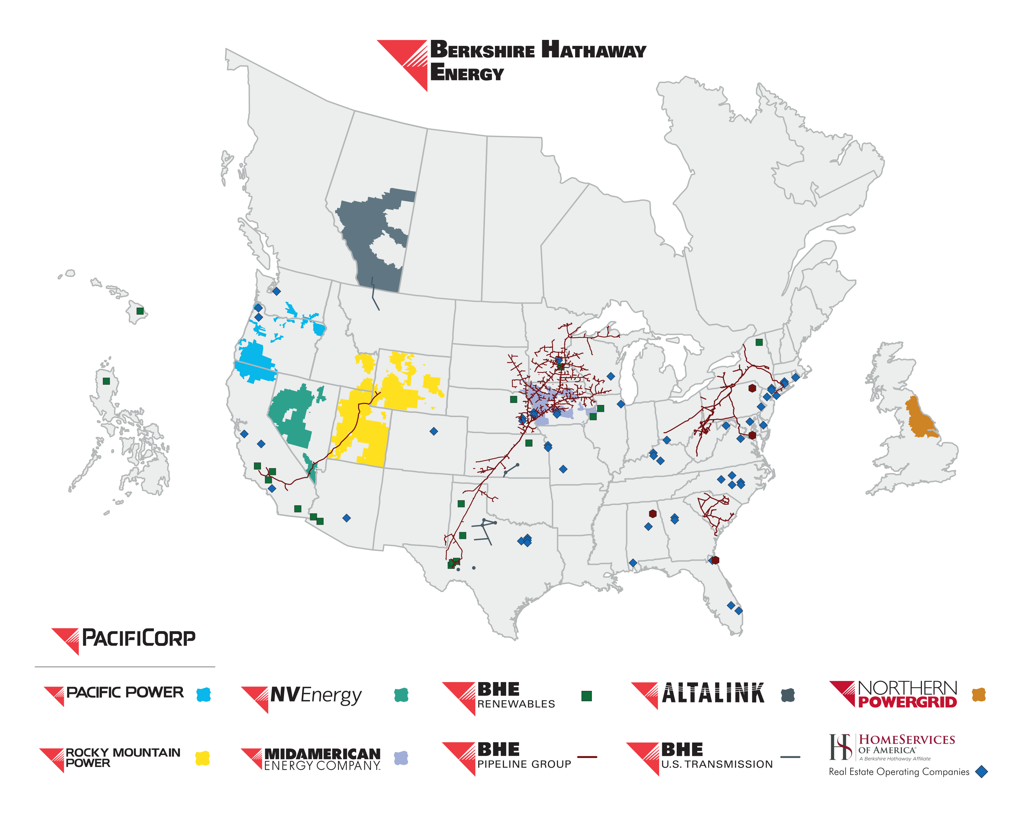
Berkshire Hathaway Energy

Slide 3
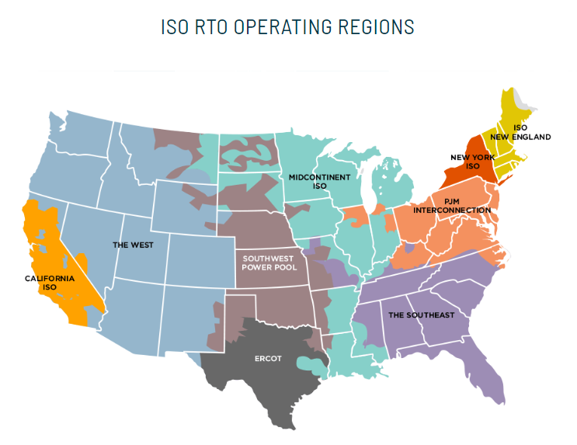
The “Greater Grid”
MidAmerican is a member of the MidContinent Independent System Operator (“MISO”)
MISO’s resources include 190 GW of total resources of which 29 GW are wind and 4 GW are solar

Slide 4
Resource Transition
Current State
The MISO region in the Midwest has undergone a significant resource transition in the past fifteen years with approximately 29,000 MW of wind and more than 4,000 MW of solar installed; at the same time, 17,000 MW of coal generation has retired
In the upper Midwest, four states (Illinois, Michigan, Minnesota and Wisconsin) have carbon-free or carbon-neutral by 2050 goals and multiple utilities in all states have carbon free goals by 2050
The generation reserve margin has tightened with a shift in the focus from summer-peak afternoon to generation shortages in winter twilight and late spring
MISO’s Multi-Value Project initiative first approved by the MISO Board in 2011 resulted in 2,000 miles of 345 kV and 765 kV transmission lines being constructed over a nine-state area over a period from 2013 through 2020
While the MVP portfolio has been enormously beneficial in terms of enabling more than 10 GW of renewable development, relieving congestion and providing local reliability benefits, the transmission system is once again significantly constrained
In response, MISO has approved “Tranche 1” Long Range Transmission Planning projects

Slide 5
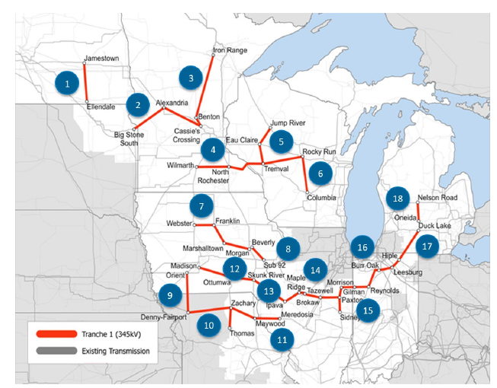
Long Range Transmission Planning Tranche 1 Overview
  In July 2022, MISO approved a set of 18 Long Range Transmission Planning Projects
    The Projects total more than 2,000 miles of 345 kV lines across nine states at a total cost of $10.4b
  MidAmerican and ITC Midwest will build nearly 500 miles of 345 kV lines in Iowa, totaling $2b
  Iowa customers will experience a b/c ratio between 3 and 4

Slide 6
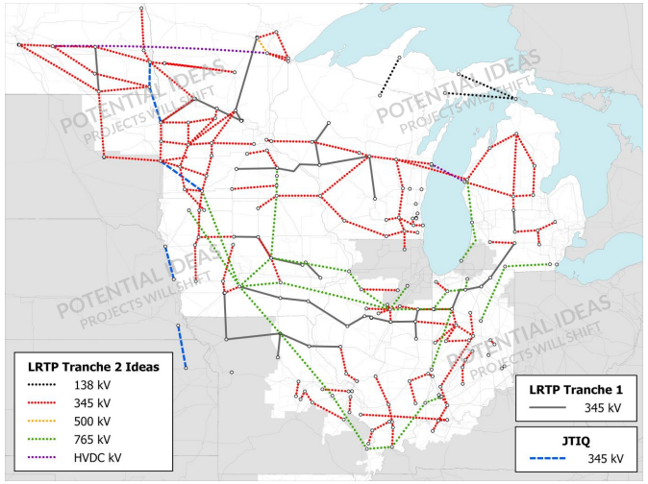
LRTP Projects Tranche 2
Tranche 2 will consider futures with much higher amounts of renewables and electrification
Key choice between many lines using traditional 345 kV voltages or fewer lines at 765 kV
MidAmerican believes some buildout of each voltage makes the most sense in order to:
  Provide local reliability benefits
  Provide for more corridors to connect new renewables
  Allow for greater flows from regions experiencing “excess” renewables in a given hour or day to regions experiencing shortfalls at that same time

