Slide 1





Grid Resilience Funding
Energy Trends Workshop | May 4, 2023
Stephanie Weisenbach, Program Manager
Iowa Economic Development Authority | Iowa Energy Office

Slide 2
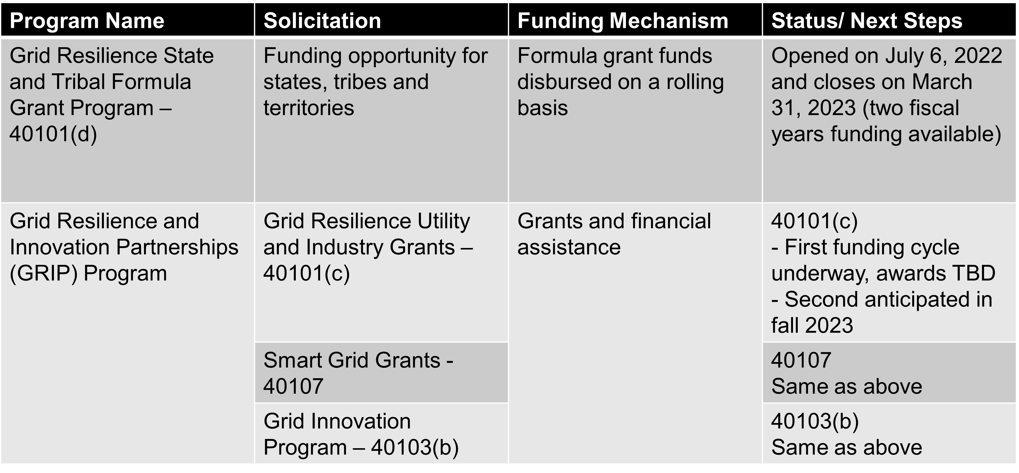
DOE Grid Funding Highlights
More info: https://www.energy.gov/gdo/grid-and-transmission-program-conductor

Slide 3
DOE Grid Resilience Formula Grant Program
Objective: Improve the resilience of the electric grid against disruptive events
Eligible entities for subawards: electric grid operators, electricity generators, transmission owners or operators, distribution providers
Awardee match requirement: 15% of state allocation
Sub awardee match requirement: 100% of subaward; however, if entity sells less than 4M MWh annually, match will be 1/3 of subaward
Expected allocation to Iowa: Approx $5.9M per year for five years, a portion of which must be set aside for small utilities.
Iowa’s application due to DOE has been submitted and approved.

Slide 4
Summary of Potential Investments
Utility pole management
Hardening of power lines, facilities, substations, of other systems
Undergrounding of electrical equipment
Replacement of old overhead conductors and underground cables
Relocation of power lines or reconductoring of power lines with low-sag, advanced conductors
Vegetation and fuel-load management
Weatherization technologies and equipment
Monitoring and control technologies
Enhancing system adaptive capacity (microgrids, battery-storage)
Advanced modeling technologies
CANNOT be used for new electric generating facilities or cybersecurity

Slide 5
Iowa’s Application to DOE
Objectives
  Increase grid resilience: both preventative measures and improve asset management through evaluation and monitoring
  Facilitate faster service restoration
  Benefit underserved to reduce the impact of outages
  Expand workforce to secure and retain quality jobs
Criteria to evaluate subaward applications (12 total)
  Program thresholds/requirements: eligible entity, sufficient set-aside for small utilities, previous funding/ applications to IEDA or DOE
  Qualitative: community benefits, grid improvement impact, benefitting underserved populations, technology innovation, workforce development plan
  Implementation: project schedule, compliance burden (federal req’s + project type), admin capacity, need for financial assistance

Slide 6
Iowa’s Application to DOE
Methods for distributing funds and monitoring outcomes
  Competitive application process through online application system
  Identify and try to help overcome capacity constraints for small utilities
  Establish minimum and maximum requests
  Encourage timely completion of projects
  Provisional metrics to quantify impact of projects, examples may include
    Reduction in number and/or duration of outages
    Critical infrastructure impacted/ served by the project
    Number of underserved customers benefitted
    Jobs enhanced through new training and skills

Slide 7
Iowa Grid Resilience Fund Next Steps
Application cycle estimated sometime in CY 2023
IEDA to review applications using the criteria
Proposed subawards will be provided to DOE to verify compliance with federal requirements.
Federal requirements including but not limited to Build America, Buy America (BABA), Davis Bacon Act (prevailing wage), environmental review, ongoing reporting.

Slide 8
Iowa Grid Resilience Fund Next Steps
Optional preparation steps for applicants
  Evaluate strategies to identify underserved/vulnerable households and potential needs
  Evaluate any baseline data associated and potential to measure post-project metrics
  Assess workforce related challenges (in-house or external) and longer-term skillset needs
  Evaluate local match and other programs https://www.iowaeda.com/iowa-energy-office/energy-loans or Grants | IOWA HSEMD
  Consider potential projects for applying to Iowa Grid Resilience Fund
    Minimum/ maximum awards TBD. Awards over $1M unlikely.
    Communicate with engineer(s), potential estimates, supply chain challenges, etc.
Education on potential projects and strategies
  GridWise Technology Portfolio White Paper - GridWise Alliance
  Resilient-energy.org by National Renewable Energy Laboratory
https://www.iowaeda.com/iowa-grid-resilience-fund
Contact: stephanie.weisenbach@iowaeda.com or 515-348-6221

