Slide 1





Energy Trends Workshop
IEDA Energy Office Updates & Federal Funding Programs | May 4, 2023
Brian Selinger | Jeff Geerts | Amber Buckingham
Iowa Economic Development Authority | Iowa Energy Office

Slide 2
Energy Office Updates
Thanks, Dan Nickey for the invite!
Active times w/current grant and loan programs and,
IIJA & IRA providing unprecedented number of new programs and funding
New federal opportunities have seemed like a hurry up and wait situation
Energy Office has a dedicated program manager for each new & existing opportunity

Slide 3
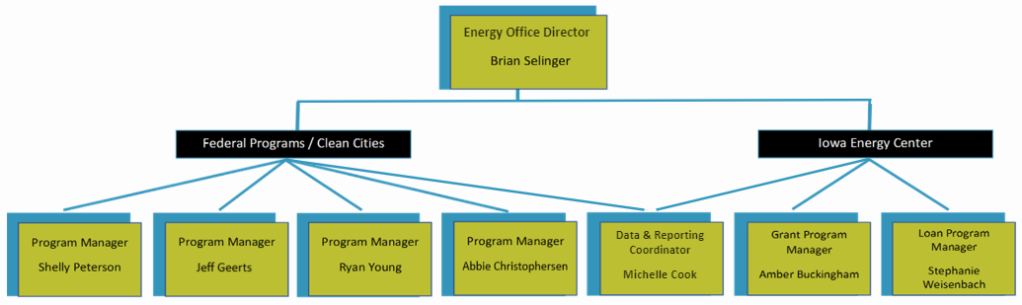
Energy Office - Personnel

Slide 4
Energy Office – Committees, Boards, task forces
Energy Office led and/or participated in the activities of the following Iowa boards, committees, workgroups, and task forces:
Iowa Energy Plan
(2015-2016)
Iowa Carbon Sequestration Task Force
(2021-2022)
Iowa Hydrogen Hub Exploratory Workgroup
(2022)
Iowa Biomass Conversion Action Committee
(2017-2018)
Iowa Energy Center Board
(2017-present)
Iowa Energy Storage Action Committee
(2018-2019)
Iowa Electric Vehicle Infrastructure Steering Committee
(2018-2019)

Slide 5
Regional Clean Hydrogen Hub Opportunity
DOE has $7 billion available to designate / fund 6-10 regional clean hydrogen hubs
Iowa partnered with Nebraska and Missouri to form proposed regional hub
Reportedly, 79 concept papers received, 33 encouraged by DOE to submit full application (our proposed hub was encouraged)
Full application was due April 7, 2023 / DOE decision expected summer/fall 2023
If successful, funding would support known regional projects and align with emerging hydrogen-related economic development opportunities

Slide 6
Energy Efficiency Revolving Loan Fund (EERLF)
EERLF enables states to provide loans and grants to conduct commercial & residential energy efficiency upgrades/retrofits of building infrastructure
A qualifying audit must be conducted prior to initiating a retrofit project
Iowa Energy Office is the authorized representative of these funds
IEDA to be allocated $6.7M to develop or supplement existing loan program
An application for funding must be submitted to DOE by May 26, 2023
Program highlights
  5 years lifespan
  Loan terms < 15 years
  States may retain the funds after cycled through; federal requirements then expire
  States can select preferred interest rate%

Slide 7
DOE Grid Resilience Formula Grant Program
Objective: Improve the resilience of the electric grid against disruptive events
Formula allocation to Iowa: Approx $5.9M per year for five years, a portion set aside for small utilities. IEDA to set up Iowa Grid Resilience Fund.
Use of funds: Specific grid resilience measures. Examples include monitoring and control technologies, hardening of power lines, undergrounding infrastructure.
Eligible entities for subawards: electric grid operators, electricity generators, transmission owners or operators, distribution providers
Awardee match requirement: 15% of allocation
Sub awardee match requirement: 100% of subaward; however, if entity sells less than 4M MWh annually, match will be 1/3 of subaward
Iowa’s application due to DOE has been submitted and approved.

Slide 8
Iowa Grid Resilience Fund Next Steps
Application cycle estimated summer/fall 2023
Proposed subawards will be provided to DOE to verify compliance with federal requirements.
Federal requirements including but not limited to Build America, Buy America (BABA), Davis Bacon Act (prevailing wage), environmental review, ongoing reporting.
More information at https://www.iowaeda.com/iowa-grid-resilience-fund

Slide 9
Energy Infrastructure Revolving Loan Program
Approximately $12M available, quarterly application cycles
  Loan awards approved by the Iowa Energy Center Board
Eligible applicants: businesses, RECs and municipal utilities
Loan Amounts: Minimum $50,000, Maximum $2,500,000 and can cover up to 75% of project costs
Loan Terms: Up to 15 years
Interest Rate: 2%
Eligible projects facilitate electricity or gas, transmission, storage or distribution. Innovative technologies are encouraged.
More information: https://www.iowaeda.com/iowa-energy-office/energy-loans

Slide 10
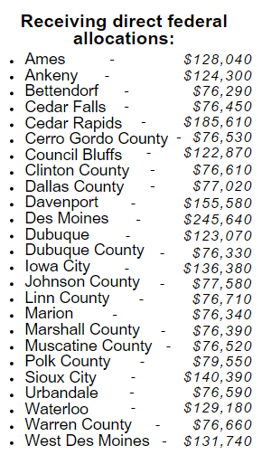
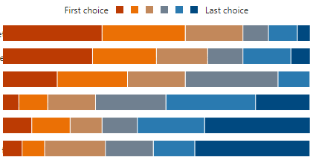
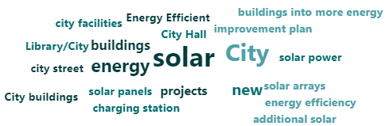
Energy Efficiency and Conservation Block Grant Program
Iowa Energy Office to receive $2,004,050
Preliminary survey results:
96 responses
Blueprint Topic Areas
Energy efficiency (e.g., building audits and retrofits, building electrification campaigns, building performance standards)
Renewables (e.g., solar and battery storage power purchasing agreements, solarize campaigns, renewable resource planning for communities)
Energy planning
Sustainable financing solutions for energy projects and programs
Workforce development
Transportation (e.g., electric vehicles for fleets, EV charging infrastructure for the community)
1.
2.
3.
4.
5.
6.
Pre-award information sheet submitted & approved.

Slide 11
High Efficiency Electric Homes Rebate Act
Rebate program to support low to moderate income households who electrify their homes.
  Iowa will receive ~$60M
  10 year program
Point of sale rebates – up to $14,000 per household
  For HVAC projects, rebates can be assigned to the installation contractor.
Could cover up to 100% of project costs for low-income households and 50% of project costs for moderate-income households.
Multifamily units qualify if at least 50% of residents are low to moderate income.
New construction may qualify for rebates.
Incentivizes contractors to perform electrification projects in LMI qualifying households.
Existing/Baseline equipment must utilize natural gas to qualify for the rebate.
Can be used in conjunction with utility rebates and tax incentives.

Slide 12
HEEHRA Rebates
Rebates for Qualified Electrification Projects
Project Type | Low-Income (<80% AMI) | Moderate-Income (80%-150% AMI)
Heat Pump HVAC | $8,000 | $4,000
Heat Pump Water Heater | $1,750 | $875
Electric Stove/Cooktop | $840 | $420
Heat Pump Clothes Dryer | $840 | $420
Breaker Box | $4,000 | $2,000
Electric Wiring | $2,500 | $1,250
Weatherization | $1,600 | $800

Slide 13
Home-Owner Managing Energy Savings
Whole home energy efficiency rebate program
  Rebate amount will be determined by the total projected or measured savings for the whole house.
    Not based on the installation of individual end use applications
  Iowa will receive ~$60M
  Measured or Modeled Approach?
Larger incentive for LMI households
Existing all electric households could qualify if they install higher efficiency equipment AND meet the savings requirements.
    Example: Electric Baseboard heating replaced with ductless mini-split heat pumps.
Requires homeowners/landlords to have an audit before work is completed.
Open to homeowners that may not qualify for HEERHA
Can be used in conjunction with utility rebates and tax incentives.

Slide 14
HEEHRA and HOMES Next Steps
July 2023 – State Energy Offices expect to receive official program guidance from the Department of Energy.
States will then begin planning state specific programs.
  National repository?
  Regional or National rebate systems?
  Controlled approach?
Once states have finalized program plans, they must be submitted to DOE for approval.
Rebates will likely be available during the first quarter of 2024.

Slide 15
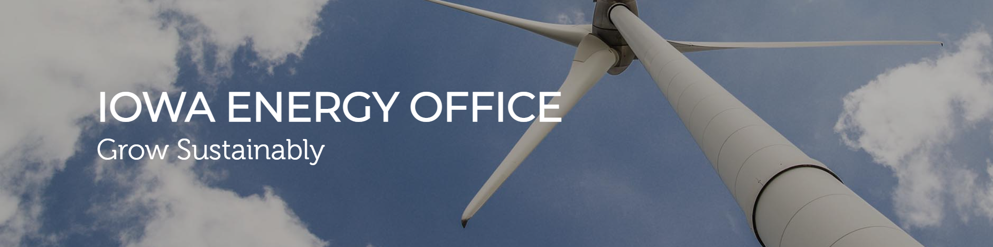
Thank you for your time. Please do not hesitate to reach out.
Questions?

Slide 16

Iowa Economic Development contact information

