Slide 1
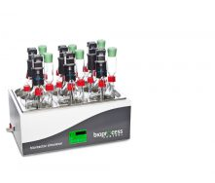

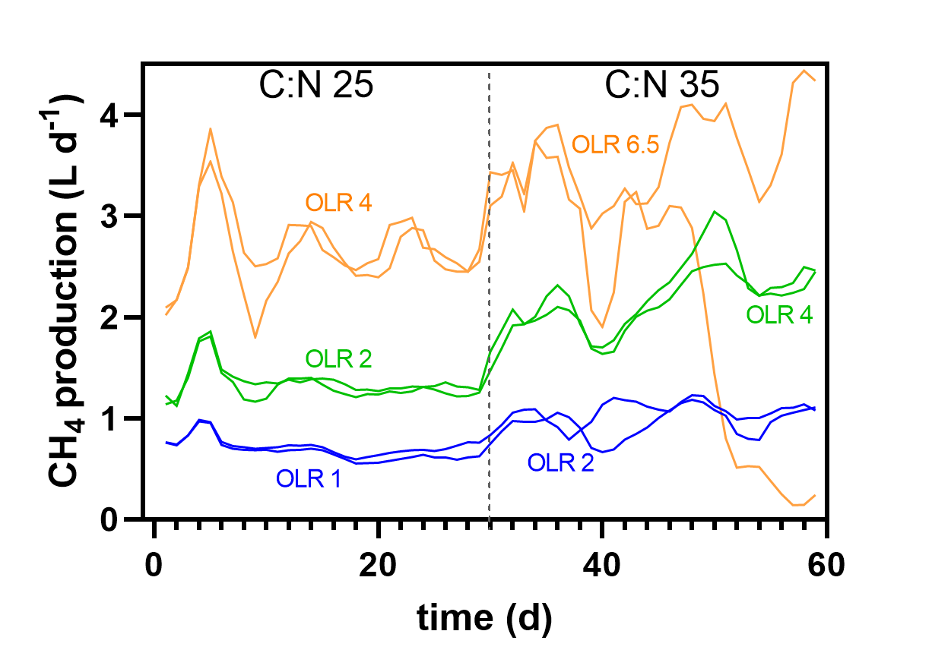
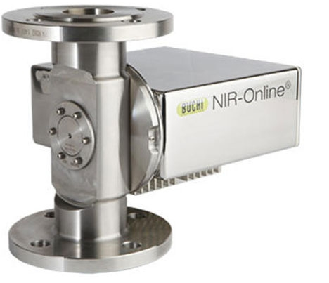
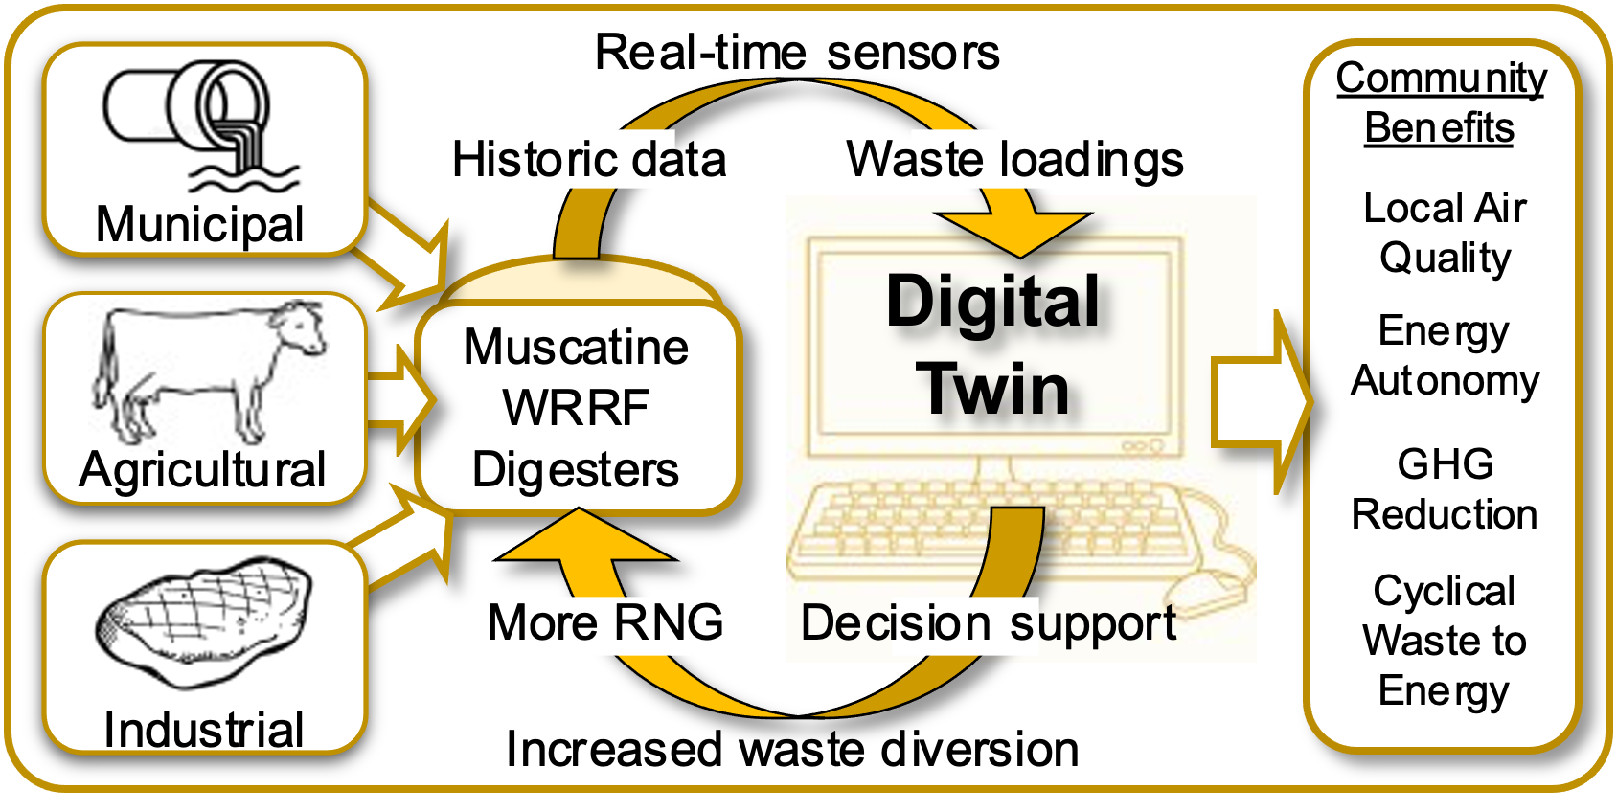







The future of RNG as an energy source in Iowa
Feedstocks & Operations
Real-time Sensing & Analytics
Machine Learning & Digital Twins
Tailored Supplements
Applied Research & Learning
Local & Global Collaboration
Profitability & Markets
AD on the Farm Conference
November 6-8, 2023
Scheman Building, Ames, Iowa
Iowa Methane Initiative
Craig Just, Associate Professor
Iowa Wastewater and Waste to Energy Research Program

